Slide 1

From PMI to Bots
Kenneth Church
July 2025

Slide 2

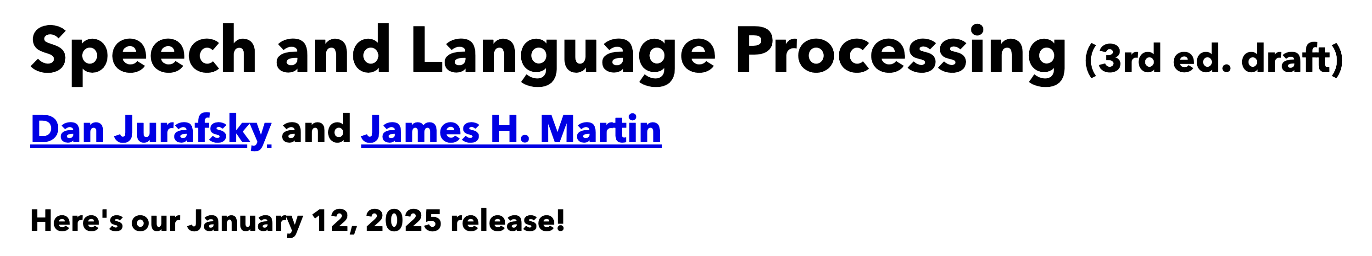
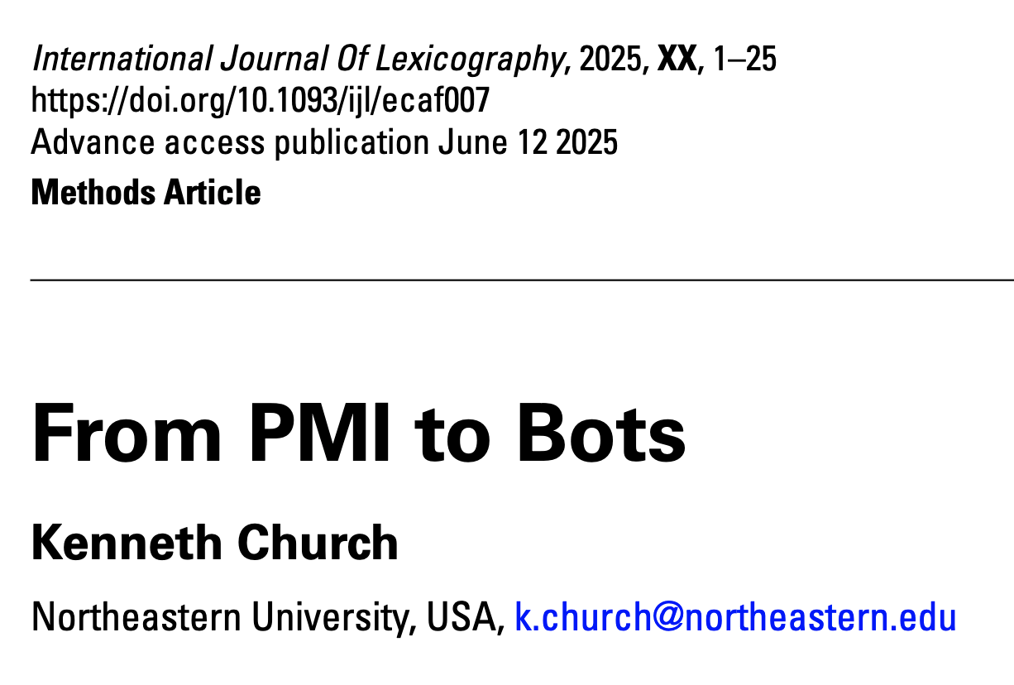
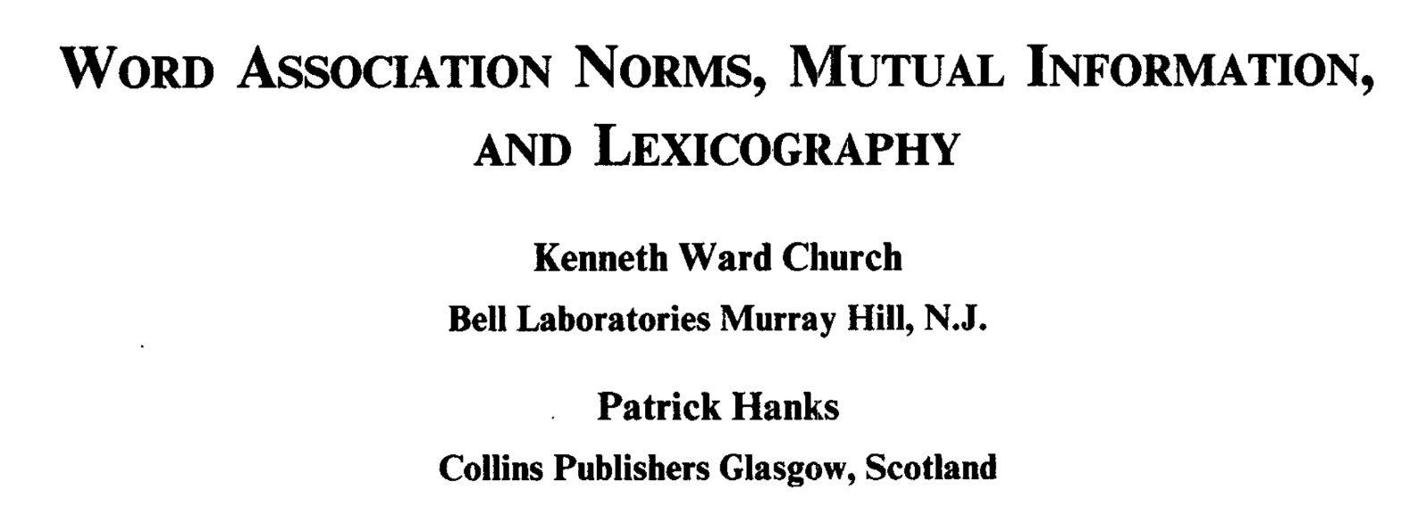
Background Reading for Today
JM: Chapter 6 (especially 6.6)
Word Association Norms, Mutual Information, and Lexicography
https://aclanthology.org/J90-1003/
From PMI to Bots (optional)

Slide 3
Chapter 6: Vector Semantics and Embeddings
Without Embeddings
With Embeddings
6.1: Lexical Semantics
6.2: Vector Semantics
6.3: Words and Vectors
6.4: Cosines (Similarity)
6.5: Term Weighting
6.6: Pointwise Mutual Information (PMI)
6.7: Apps of TF-IDF & PMI
6.8: Word2Vec
6.9: Visualizing Embeddings
6.10: Semantic Properties of Embeddings
6.11: Bias and Embeddings
6.12: Evaluating Vector Models
6.13: Summary

Slide 4
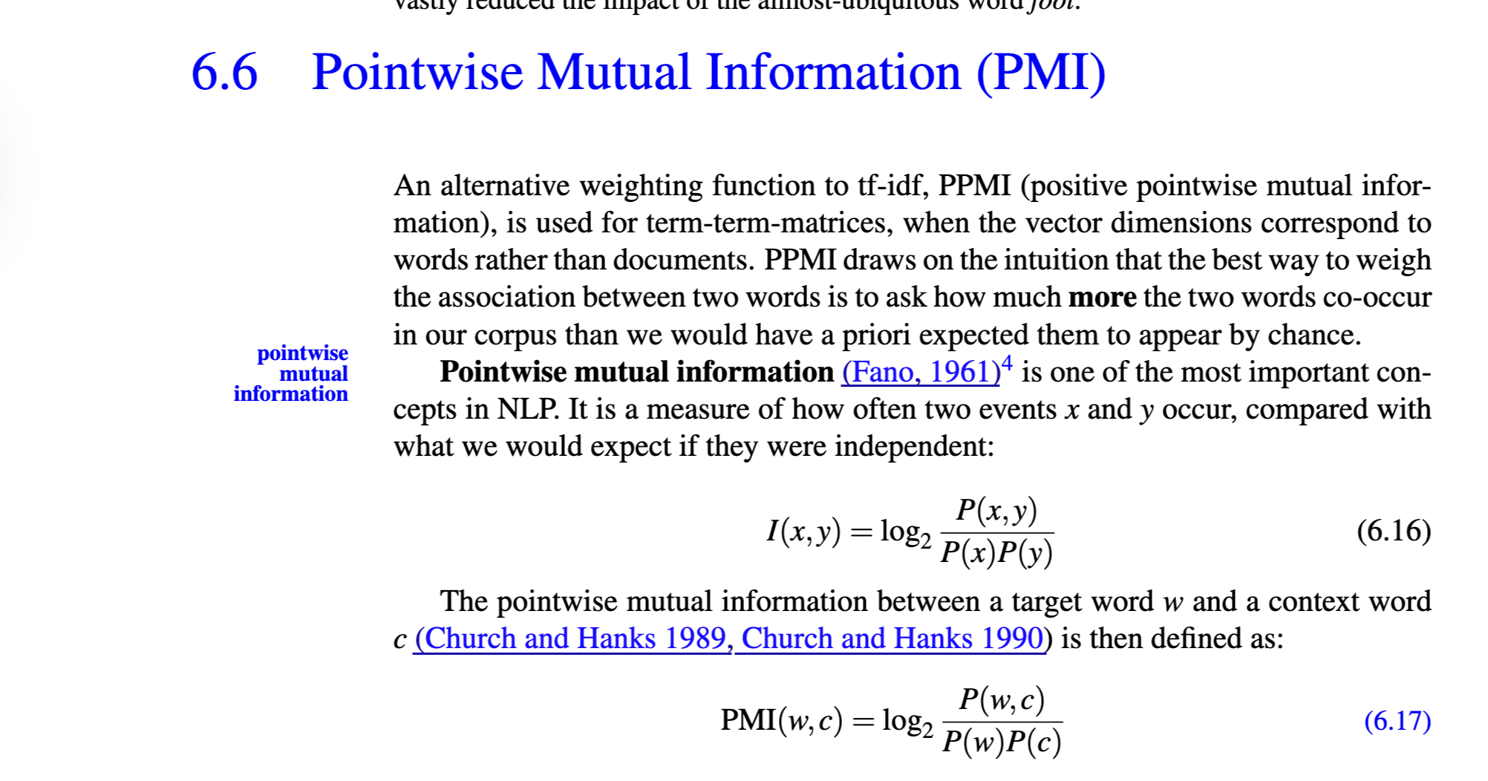
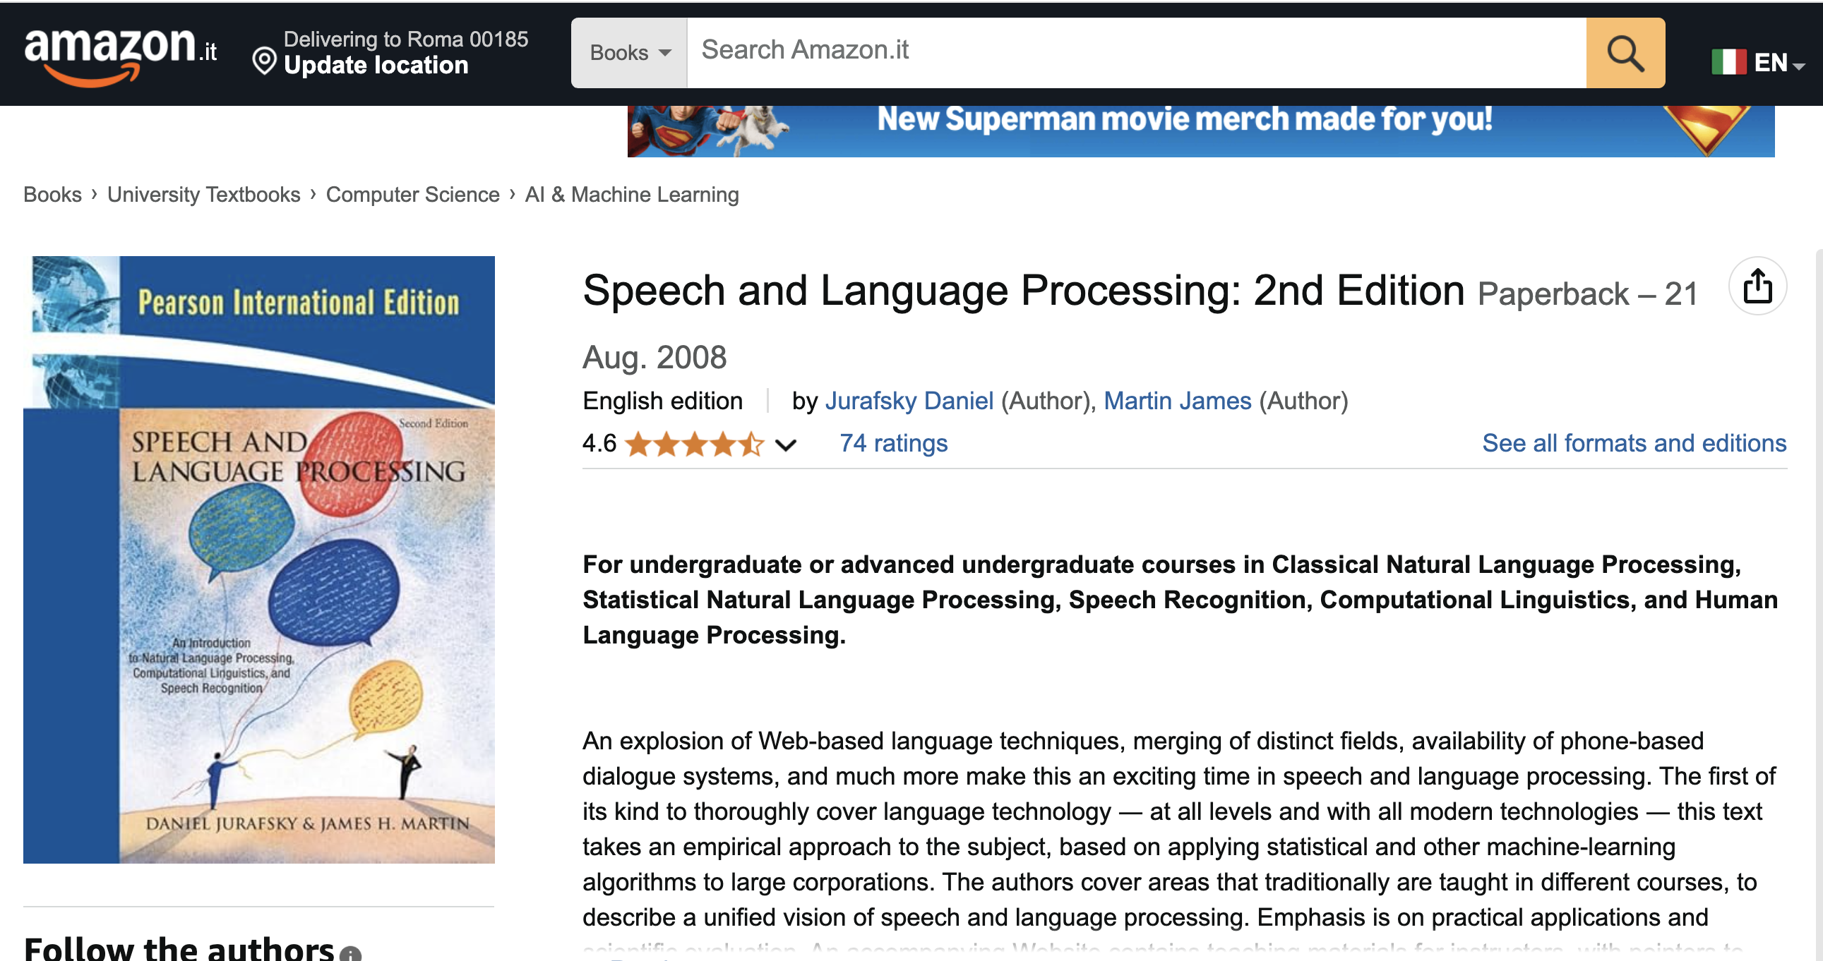
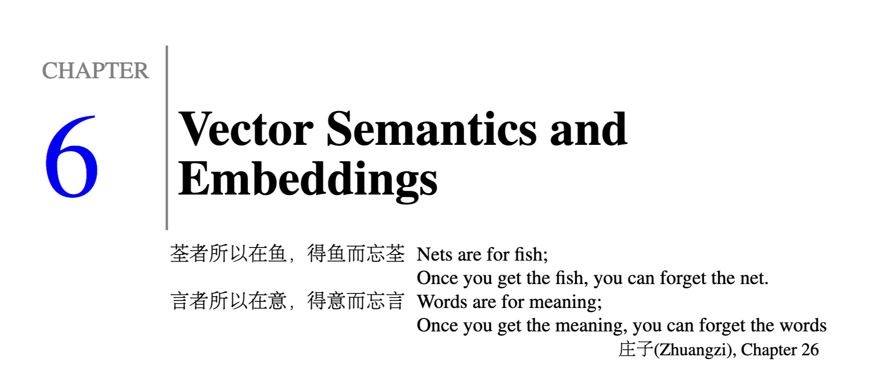

Slide 5
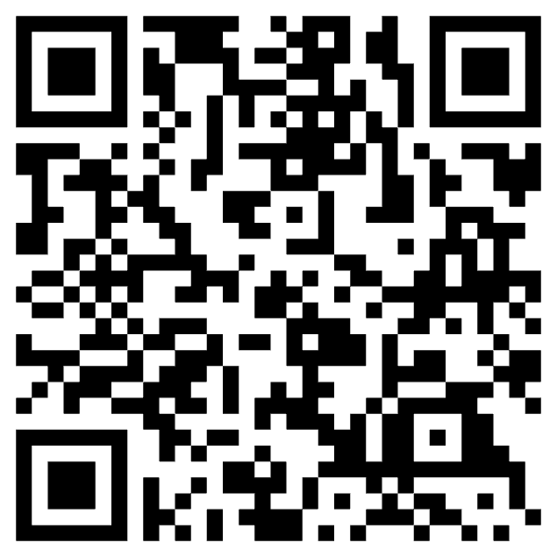
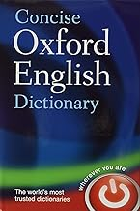
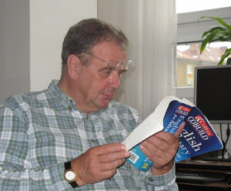
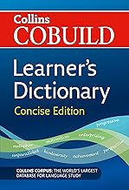
Special Issue of International Journal of Lexicography in Memory of Patrick Hanks

Slide 6
Agenda
Bigger Picture: A personal perspective not found in textbooks
Corpora
Lexical Semantics
Word Associations
Information Theory
PMI → Word2Vec → Bots

Slide 7
Bigger Picture: A personal perspective not found in textbooks
Connecting the Dots
CogSci: Interdisciplinary
Past, Present and Future
Where have we been and where are we going?
Word Associations
Psychology
Psycholinguistics
Humanities
Linguistics
Syntax, Semantics, Phonology & Phonetics
Lexicography: Corpus-based methods
Translation
Education:
Testing (Vocabulary Size)
Math
Statistics & Linear Algebra
Engineering
Information Theory, Artificial Intelligence (AI), Machine Learning (ML), Computational Linguistics (CL), Machine Translation (MT), Information Retrieval (IR), Speech & Vision
Past: PMI
Present
Future: Bots
Mutual Information
Connect Three Dots

Slide 8
From PMI to Bots Connecting the dots between the past and the future
PMI → Word2Vec → Bots
PMI (Past): Pointwise Mutual Information
Original Motivation for PMI:
Help Lexicographers to find interesting “collocations”
Need to explain “collocations”
and connect the dots between collocations and lexical semantics
Word2Vec: factored representation of PMI
Bots (Future): Word2Vec → Doc2Vec
Embeddings: Represent “everything” as vectors
Everything:
Words (in all languages)
Documents (in all languages)
Multi-modal: Text, Speech, Pictures, Videos
Answer all questions by table lookup (cosine similarity of vectors)

Slide 9

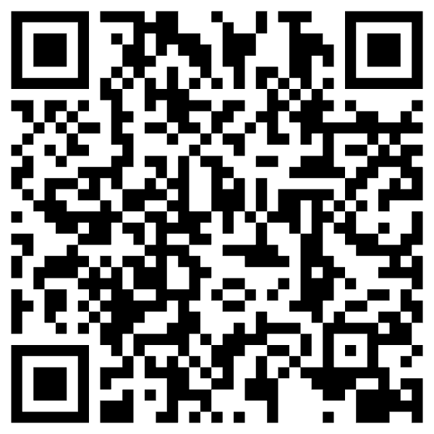
https://www.chronicle.com/article/im-a-student-you-have-no-idea-how-much-were-using-chatgpt

Slide 10
Cheating: Do’s and Don’ts
Do’s
Don’ts (Cheating)
Bots are more fluent
than trustworthy
Use bots to improve fluency
Modern version of a thesaurus
Assume responsibility
for what you say
Human-in-the-loop
Collaboration
Machines are better at fluency
Humans are more trustworthy
Traffic in misinformation
Use bots to get a good grade without mastering the material
You are only cheating yourself
End-to-End Systems
Self-organizing
Turn-key
Fire experts:
linguists, historians, programmers,
yourself

Slide 11
Bots are more fluent than trustworthy
Bots have amazing
Strengths: fluency
Weaknesses: trustworthiness (hallucinations)
On the Dangers of Stochastic Parrots:
Can Language Models Be Too Big? 🦜
Educational testing:
Measure vocabulary size
Assumption: Vocabulary size → “Intelligence” → Success in life
But vocabulary size depends on environment
“The million-word gap”
Children in richer homes → Hear more language → Larger vocabulary → More success
Note: bots have super-human vocabularies
Because they have been trained on more data
than people could read in a lifetime
Training: Psychological Reality (?)

Slide 12
Narrative/Hype: Bots are completely “new” But there is much to learn from the Past
Past
Empiricism
Find data (corpora) to settle open questions
1950s: Empiricism
(Shannon, Skinner, Firth, Harris)
1970s: Rationalism
(Chomsky, Minsky)
1990s: Revival of empiricism
(IBM, AT&T Bell Labs)
2010s: Extreme empiricism
(LLMs, ChatGPT & DeepSeek)
Distributional Hypothesis
Zellig Harris (Chomsky’s Advisor)
You shall know a word by the company it keeps
– Firth (1957)
Every time I fire a linguist,
the performance of the speech recognizer goes up
– Jelinek (2004)
There is no data like more data
– Mercer (1988)
Collocations

Slide 13
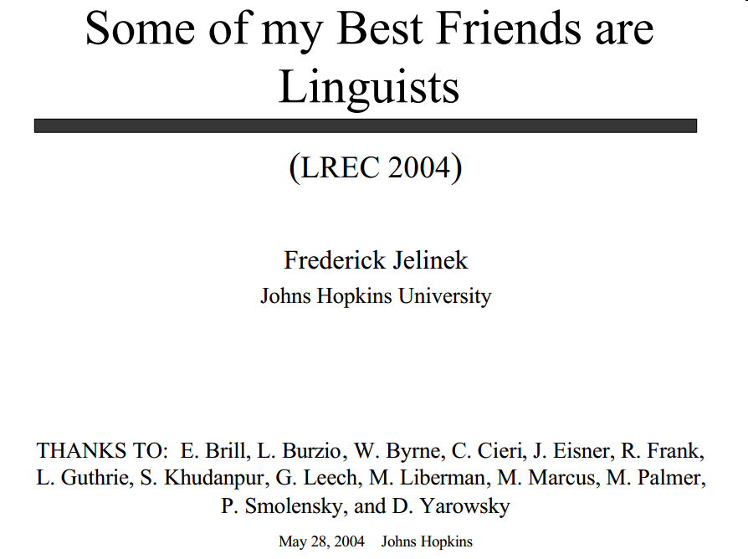

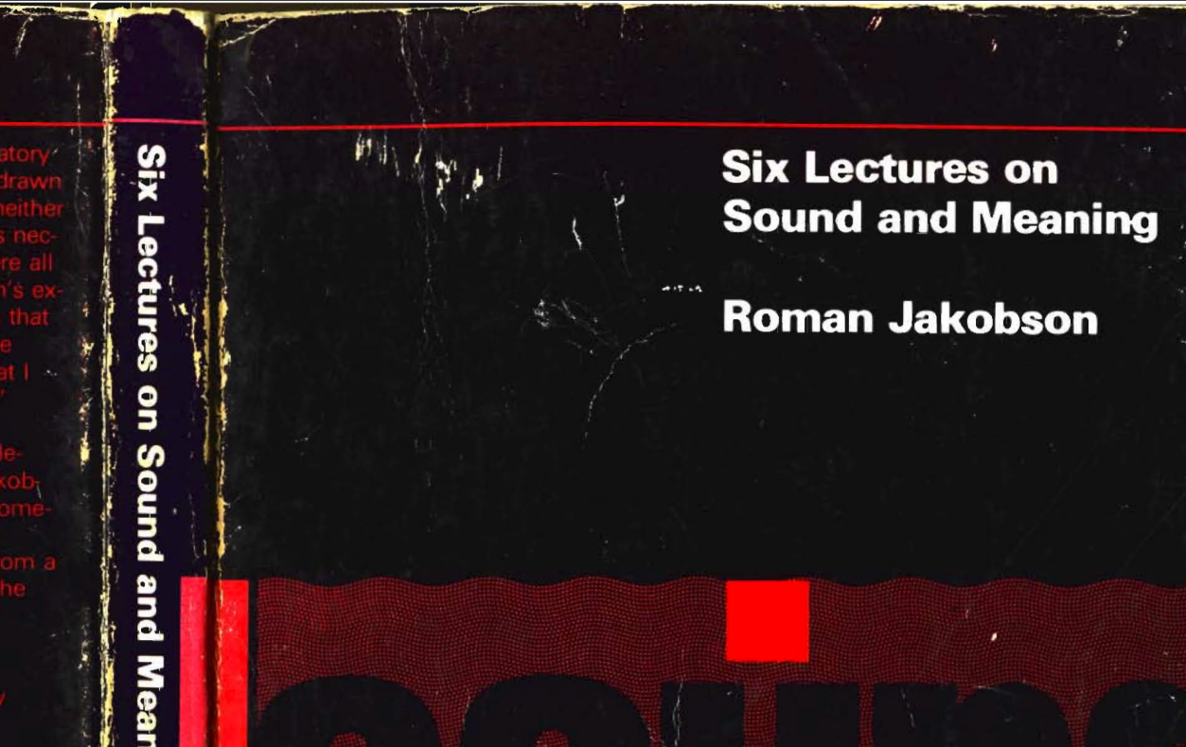
http://www.lrec-conf.org/lrec2004/doc/jelinek.pdf

Slide 14
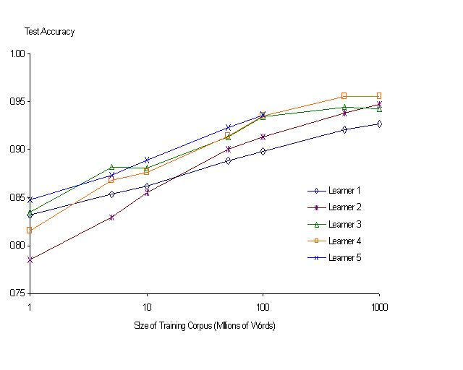
“It never pays to think until you’ve run out of data” – Eric Brill
Banko & Brill: Mitigating the Paucity-of-Data Problem (HLT 2001)
Moore’s Law Constant:
Data Collection Rates → Improvement Rates
No consistently
best learner
There is no data like more data
Quoted out of context
Fire everybody and
spend the money on data

Slide 15

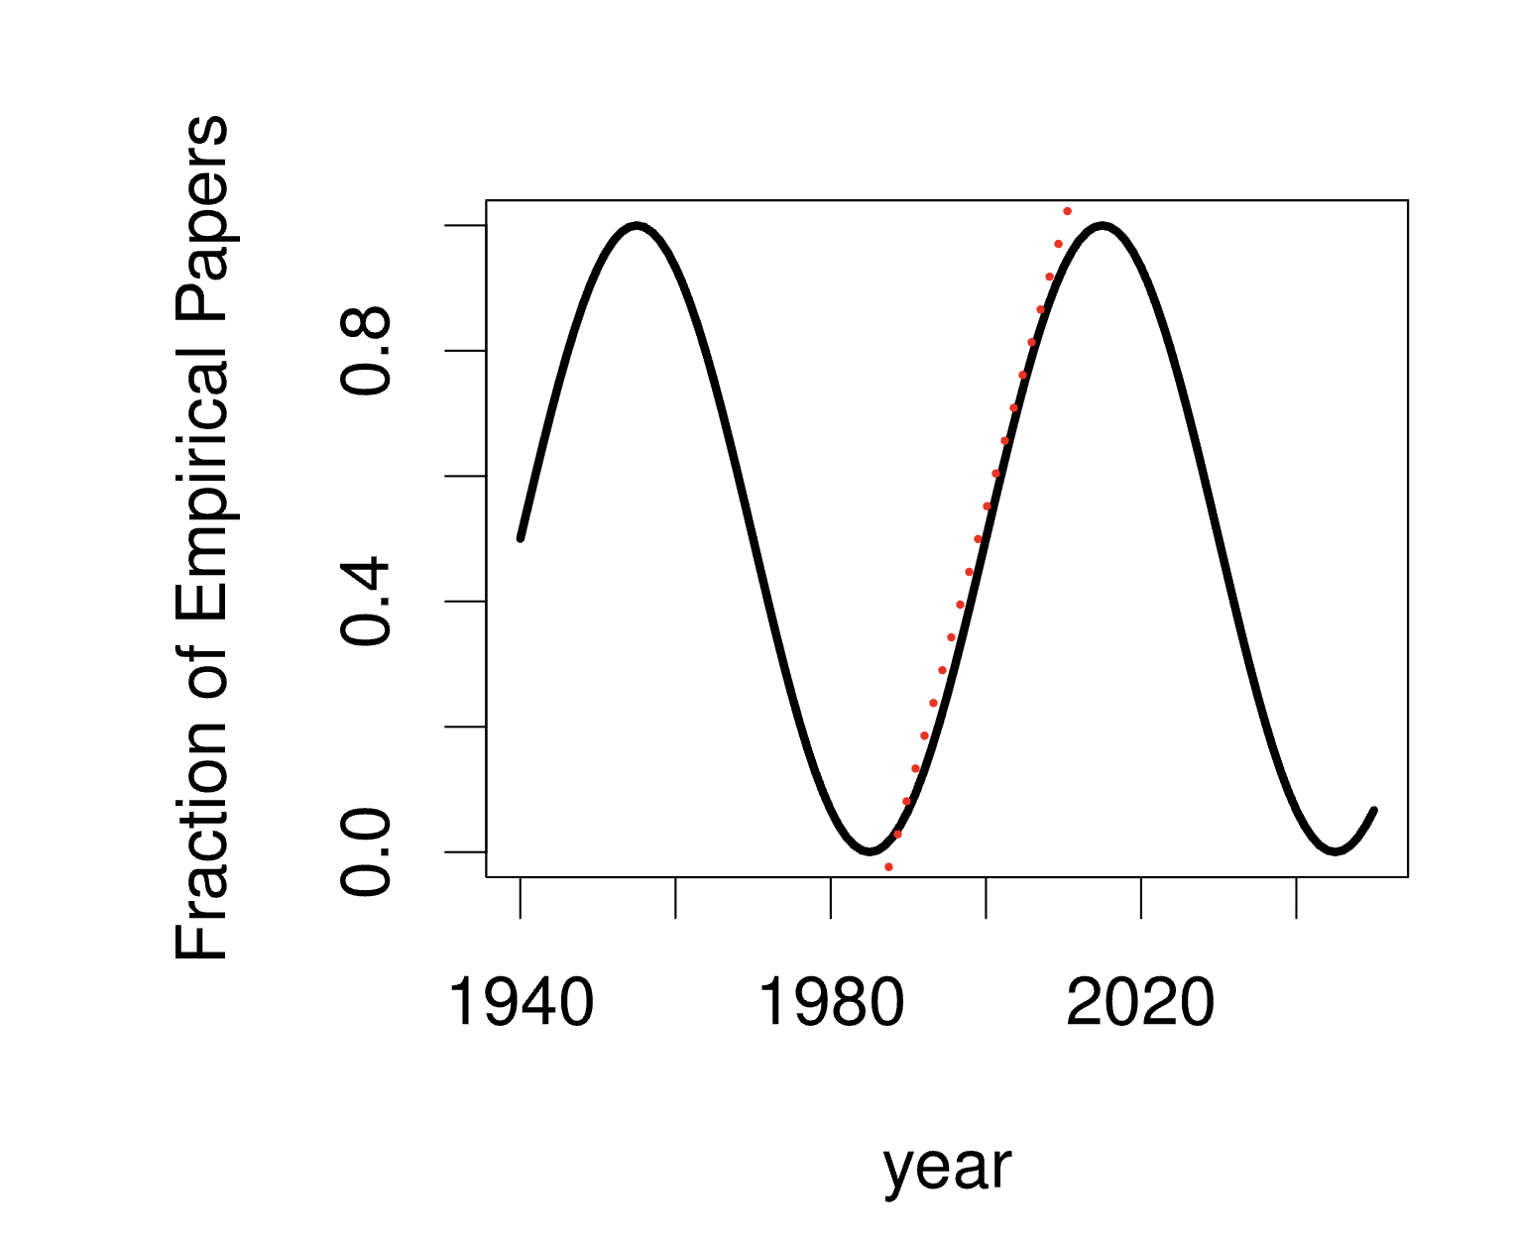
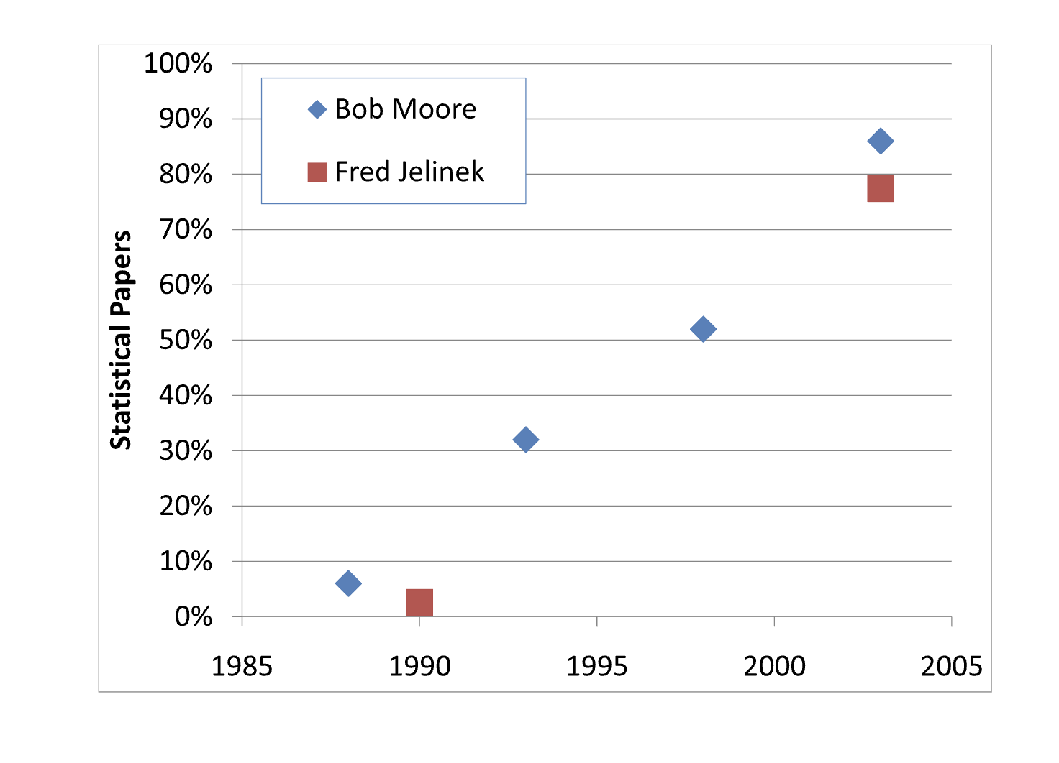
A Pendulum Swung Too Far Church, K. 2011. A Pendulum Swung Too Far. Linguistic Issues in Language Technology
1950s: Empiricism
(Shannon, Skinner, Firth, Harris)
1970s: Rationalism
(Chomsky, Minsky)
1990s: Revival of empiricism
(IBM, AT&T Bell Labs)
2010s: Revival of rationalism (?)
Extreme empiricism
(LLMs, ChatGPT & DeepSeek)
Students rebel every twenty years
Grandparents & Grandchildren

Slide 16
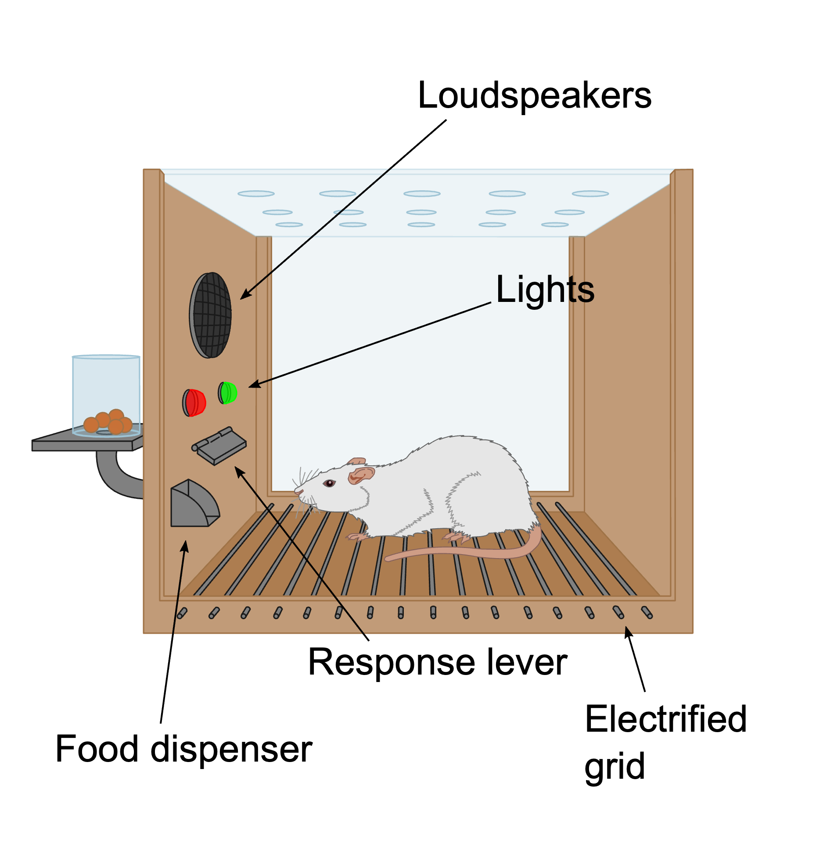
Cognitive Science in 1950s at Harvard (and later MIT & Brown)
CogSci
George Miller (CogSci)
Noam Chomsky (Linguistics)
Marvin Minsky (AI)
CogSci: Reaction to
Information Theory (Bell Labs → MIT)
Behaviorism
BF Skinner
My father (Russell Church)
Q: Have I been in a Skinner box?
A: Yes
Empiricism
Zipf
By Original: AndreasJS Vector: Pixelsquid - This file was derived from: Skinner box scheme 01.png: by AndreasJS, CC BY-SA 3.0, https://commons.wikimedia.org/w/index.php?curid=99322433

Slide 17
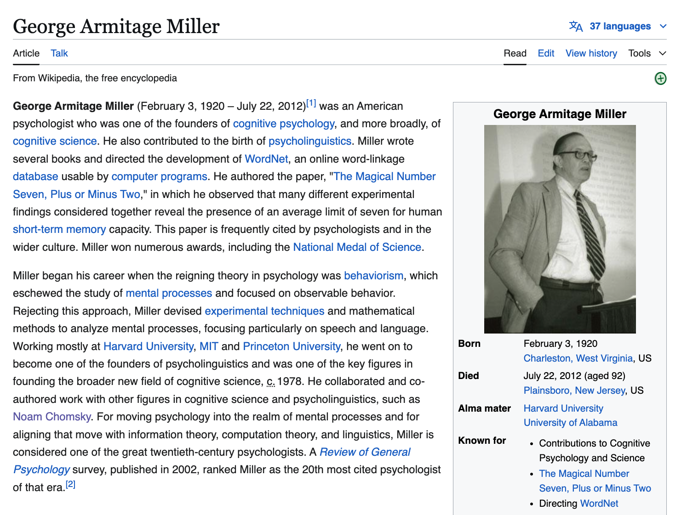
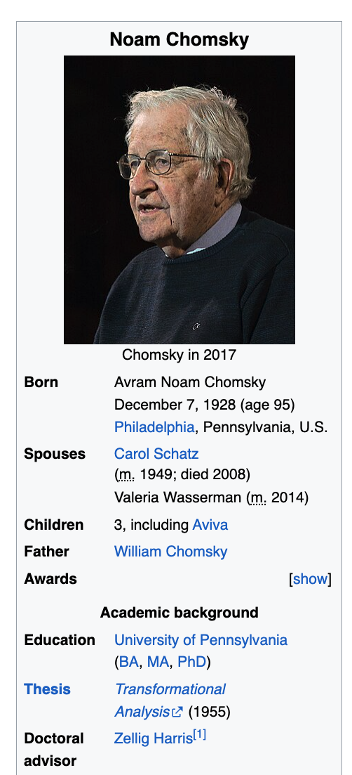

Slide 18
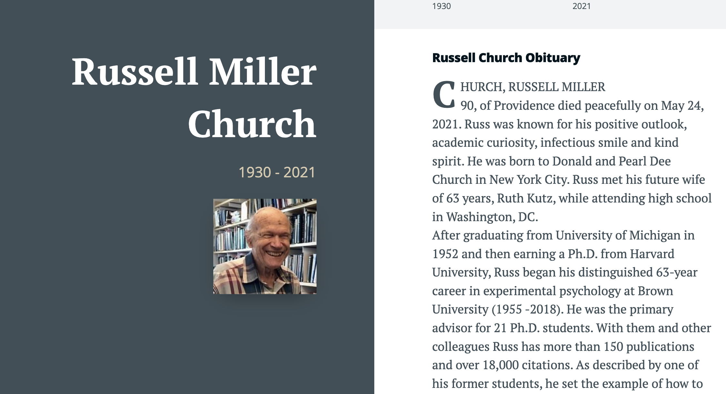

Slide 19
Agenda
Bigger Picture: A personal perspective not found in textbooks
Corpora
Lexical Semantics
Word Associations
Information Theory
PMI → Word2Vec → Bots

Slide 20
Brown Corpus: Influential over many fields
Brown Corpus: widely cited over many fields:
Information Retrieval
Baeza-Yates and Ribeiro-Neto (1999)
Lexicography
Miller (1995)
Sociolinguistics
Biber (1991)
Psychology
MacWhinney (2000)
Computational Linguistics
Marcus et al (1993)
Jurafsky and Martin (2000)
Church and Hanks (1990)
Resnik (1995)
6/27/2014
Fillmore Workshop
20

Slide 21
Brown Corpus is a Balanced Corpus (Unlike many recent catch-as-catch-can corpora)
A sample of 1M words
Contemporary (1960s)
American English
Statified over 15 genres (A-R)
500 documents
2000 words each
Many subsequent corpora
British National Corpus (BNC)
British (as opposed to American)
Larger: 1M words → 100M words
More recent (1990s v. 1960s)
15 Genres: A-R (500 documents)
Press: A (44) reportage, B (27) editorial, C (17) reviews
Religion: D (17)
Skills and hobbies: E (36)
Popular lore: F (48)
Belle-letters: G (75)
Misc: H (30): gov docs, foundation reports, industry reports, college catalog
Learned: J (80): science, medicine, math, social science, humanities, engineering
Fiction: K (29) general, L (24) mystery, M (6) science fiction, N (29) Westerns, P (29) romance, R (9) humor
There is no data like more data
6/27/2014
Fillmore Workshop
21

Slide 22
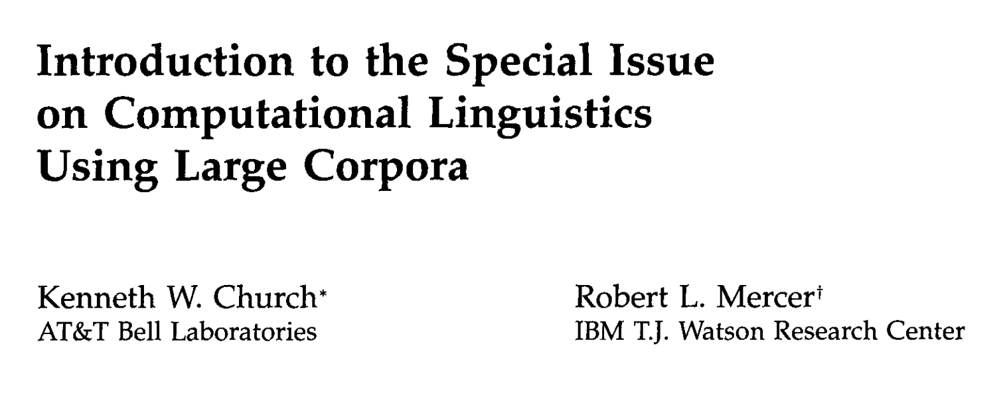
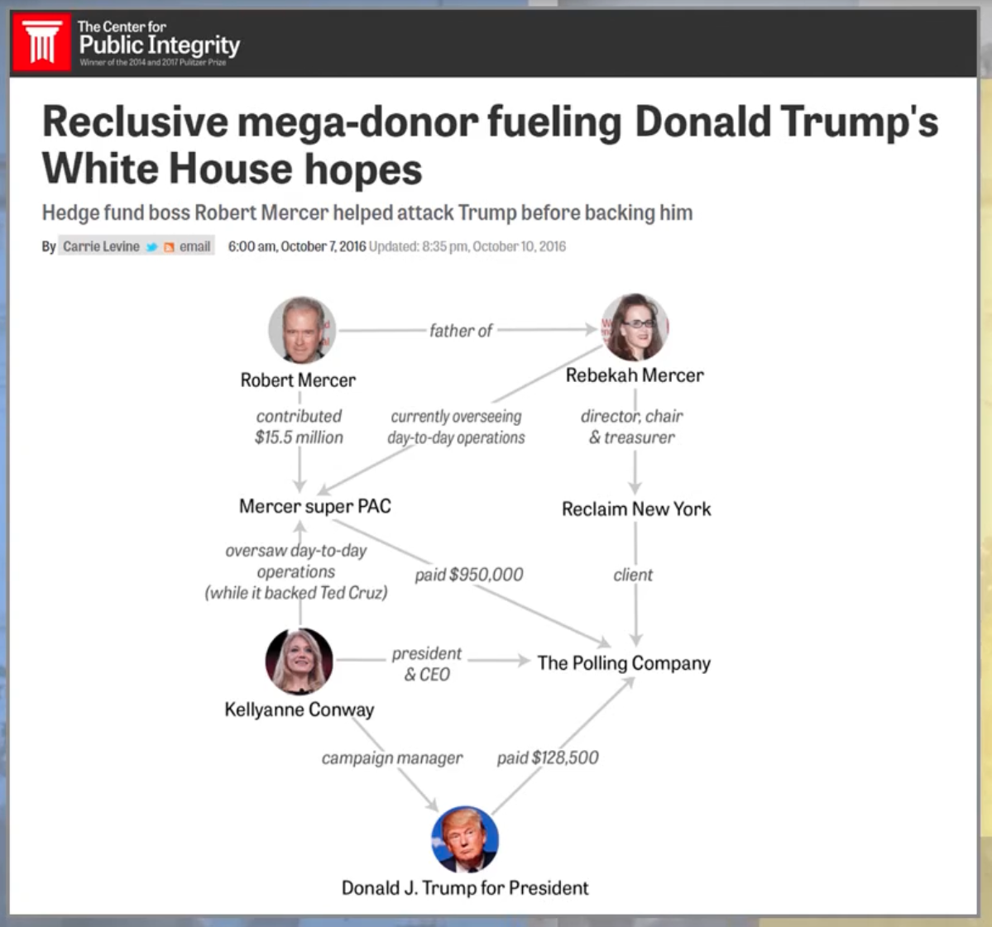

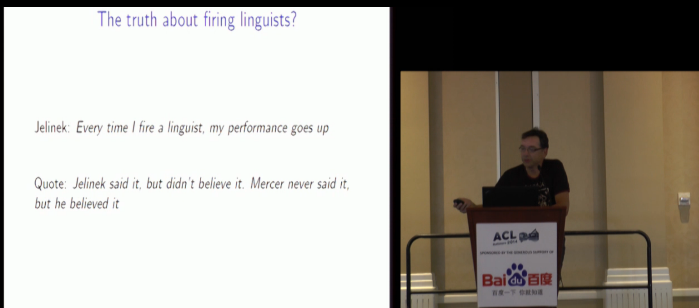
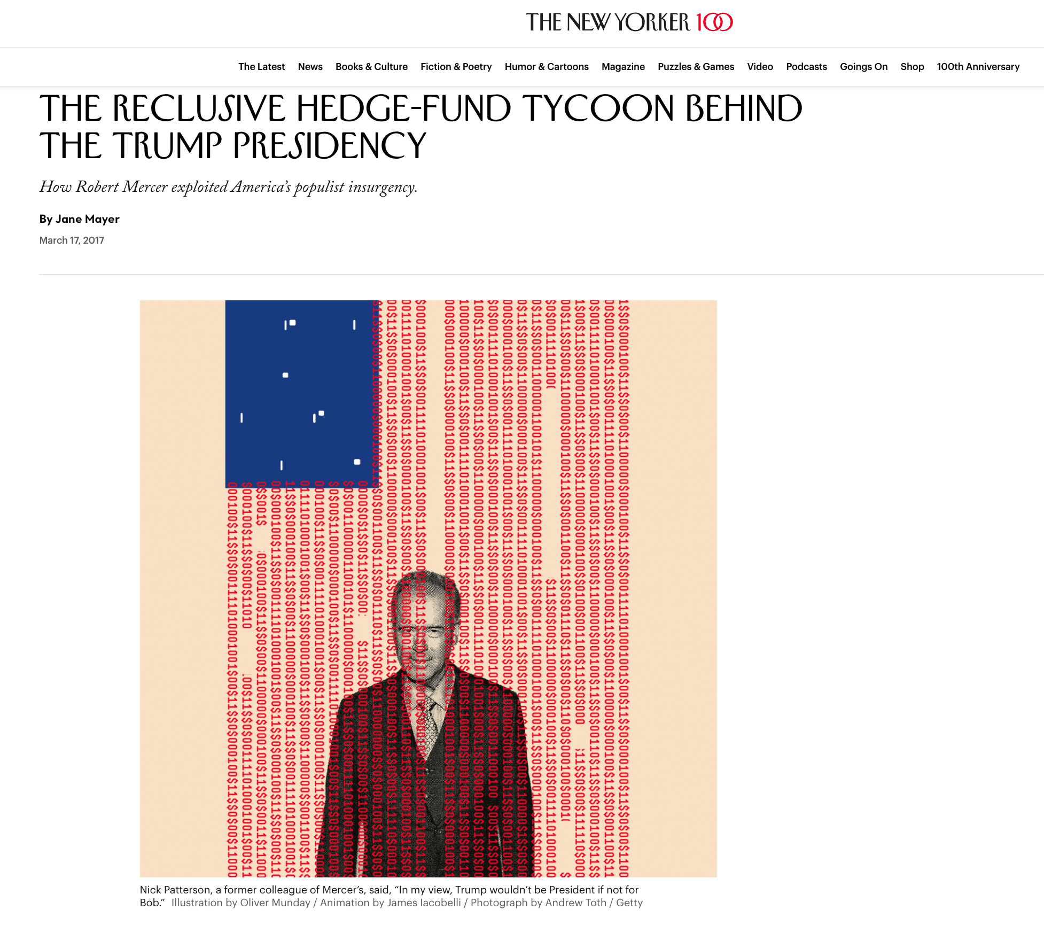

Robert Mercer ACL Lifetime Achievement
https://aclanthology.org/J93-1001.pdf

Slide 23
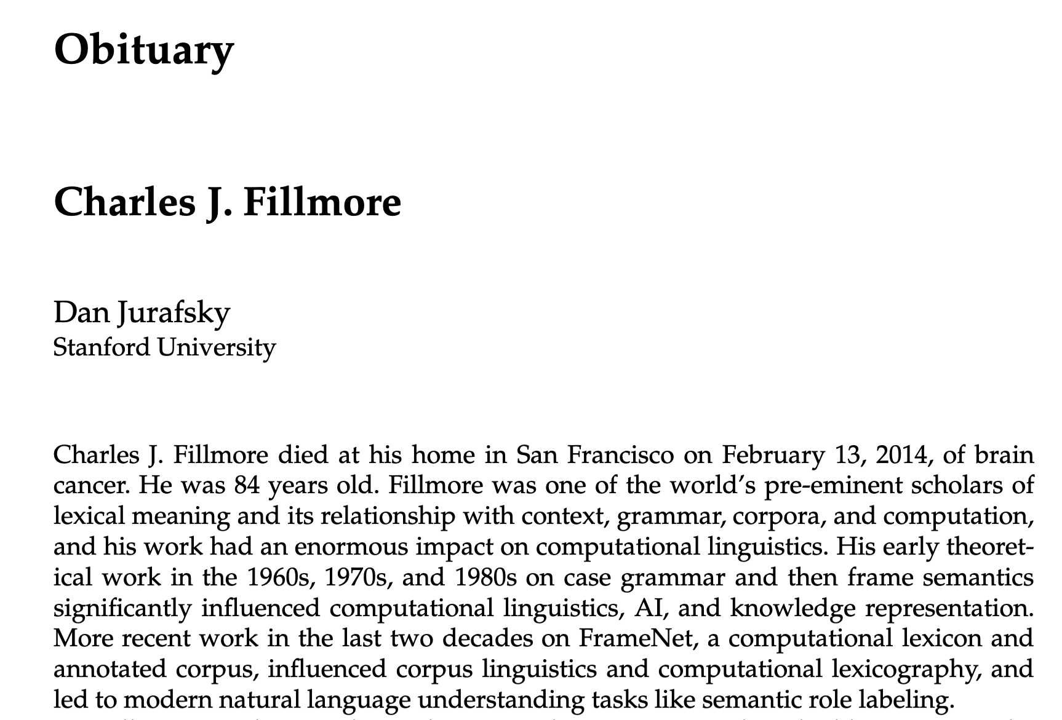

https://aclanthology.org/J14-3009.pdf
2014
2014

Slide 24
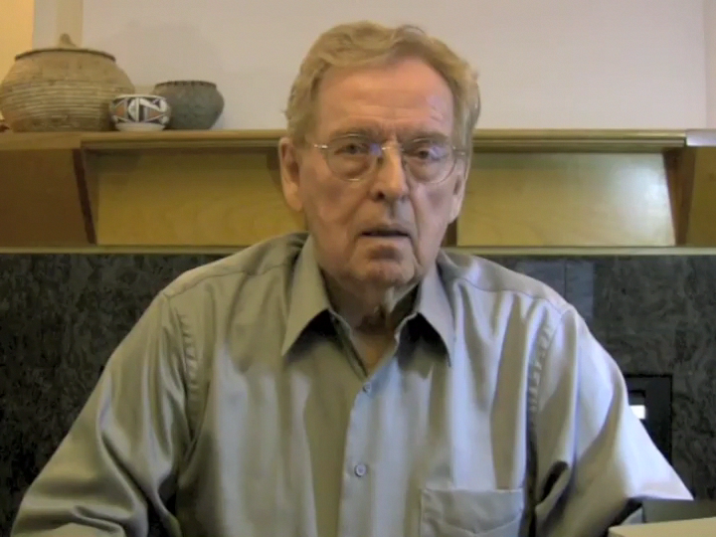
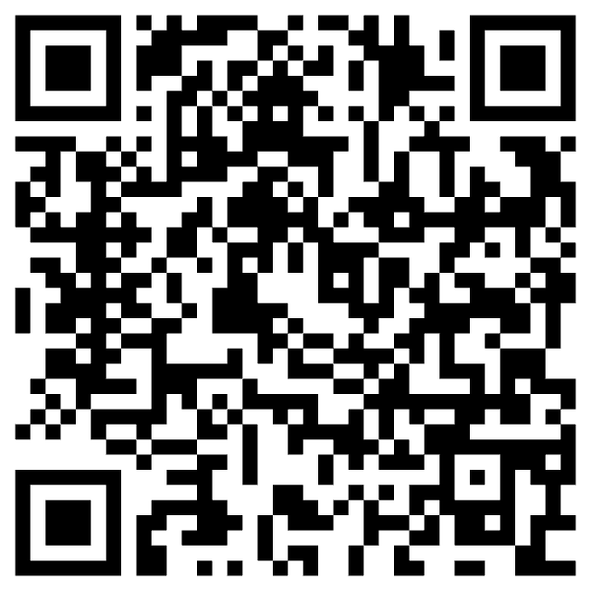
Workshop in Memory of “Chuck” Fillmore Migration from the cold: Minnesota → Berkeley
https://www.aclweb.org/adminwiki/index.php/ACL_Lifetime_Achievement_Award_Recipients

Slide 25
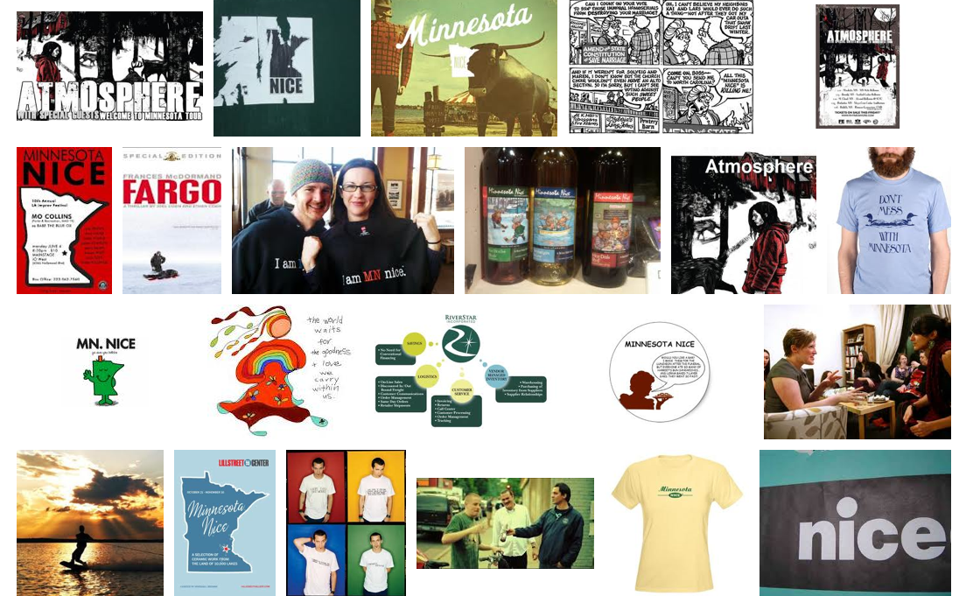
“Minnesota Nice” (Stereotypes aren’t nice, but…)

Slide 26
The “Minnesota Nice” Version
Of the story of Chuck’s migration from Minnesota to Berkeley

Slide 27
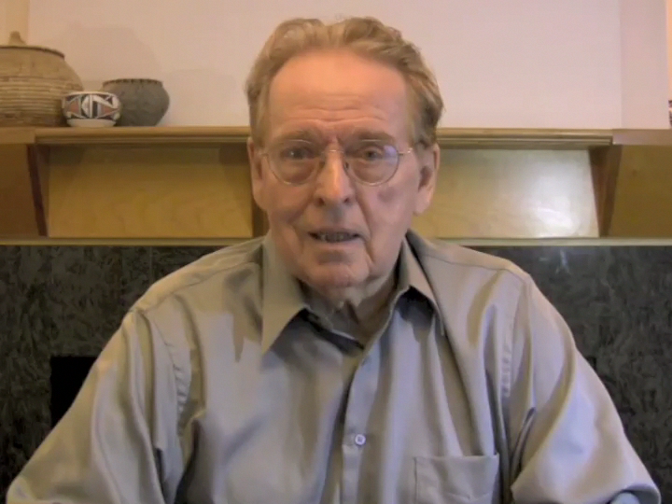
Self-deprecating humor (but don’t you believe it)

Slide 28
The Significance of Case for Case: C4C
For many of us in my generation,
C4C was the introduction to a world
beyond Rationalism and Chomsky
This was especially the case for me,
since I was studying at MIT,
where we learned many things
(but not Empiricism).

Slide 29
Case for Case (C4C): Practical Apps
Information Extraction (MUC)
Semantic Role Labeling
Key Question: Who did what to whom?
Not: What is the NP and the VP of S?

Slide 30
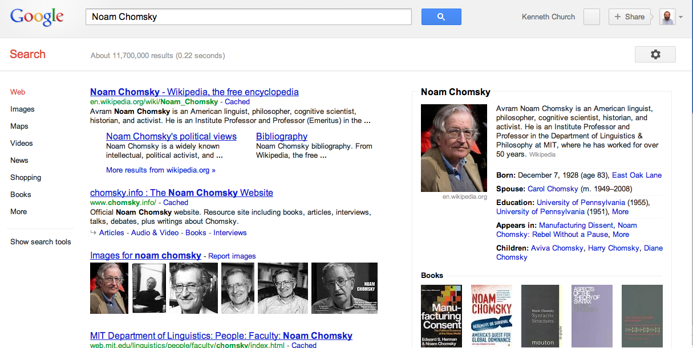
Commercial Information Extraction

Slide 31
Do Read “Case for Case”
Great arg but also
Demonstrates strong command of
Classic literature as well as
Linguistic facts
Our field:
Too “silo”-ed
Too few citations to
Classic literature, other fields and other types of facts
We could use more “Minnesota Nice”

Slide 32
Historical Motivation: A Case for Case From Morphology → MUC
Context Free Grammar is attractive for
Langs with more word order and less morphology (English)
But Case Grammar is attractive for
Langs with more morphology and less word order
Examples: Latin, Greek & Japanese
Latin (over-simplified):
Subject: Nominative case
Object: Accusative case
Indirect Object: Dative case
Other args: Ablative case

Slide 33
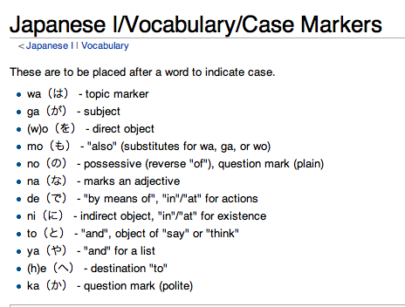
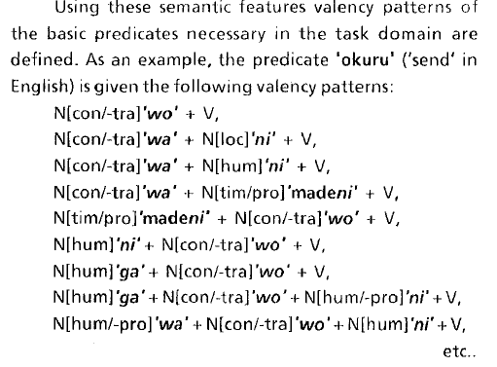
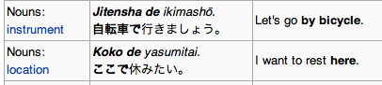

Slide 34
C4C: Capturing Generalizations over Related Predicates & Arguments
VERB | BUYER | GOODS | SELLER | MONEY | PLACE
buy | subject | object | from | for | at
sell | to
cost | indirect object | subject |  | object | at
spend | subject | on |  | object | at

Slide 35
Case Grammar → Frames / Lexicography Valency → Scripts (Roger Schank) / Lexicography (Sue Atkins)
Valency: Predicates have args (optional & required)
Example: “give” requires 3 arguments:
Agent (A), Object (O), and Beneficiary (B)
Jones (A) gave money (O) to the school (B)
Latin Morphology: Nominative, Accusative & Dative
Frames
Commercial Transaction Frame: Buy/Sell/Pay/Spend
Save <good thing> from <bad situation>
Risk <valued object> for <situation>|<purpose>|<beneficiary>|<motivation>
Collocations & Typical predicate argument relations:
Save whales from extinction (not vice versa)
Ready to risk everything for what he believes
Representation Challenges: What matters for practical apps/NLU?
Stats on POS? Word order? Frames (typical predicate-args/collocations)?
Hanks
Fillmore & Atkins

Slide 36
When can we expect to learn frames?
Corpus-size requirements:
freq(content words) ≈ parts per million
1970s Corpora: 1 M words (Brown Corpus)
Large enough to make a list of common content words
1990s: 100 M words (British National Corpus)
Large enough to see associations of common predicates with function words
“save” + “from”
Useful for parsing phrasal verbs: V NP P (Hindle & Rooth, 1993)
Most parsers are trained on Brown Corpus
(too small for phrasal verbs, let alone conjunction)
Coming soon: 1M² words (Google?)
Large enough to see associations of pairs of content words (collocations)
“give” + $$
“save” + “whale”
“save” + “extinction”
“risk” <valued object> for <purpose>
2014
Hanks
Fillmore & Atkins

Slide 37
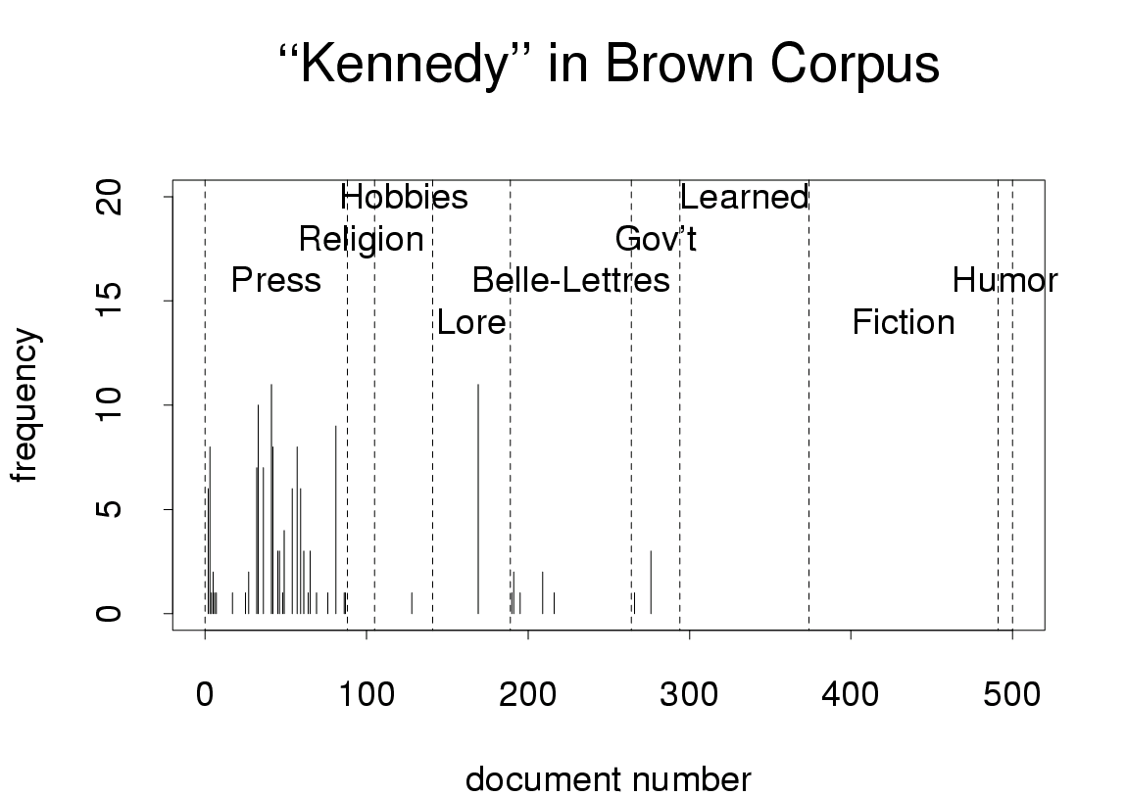
Freq depends on genre
and other factors

Slide 38
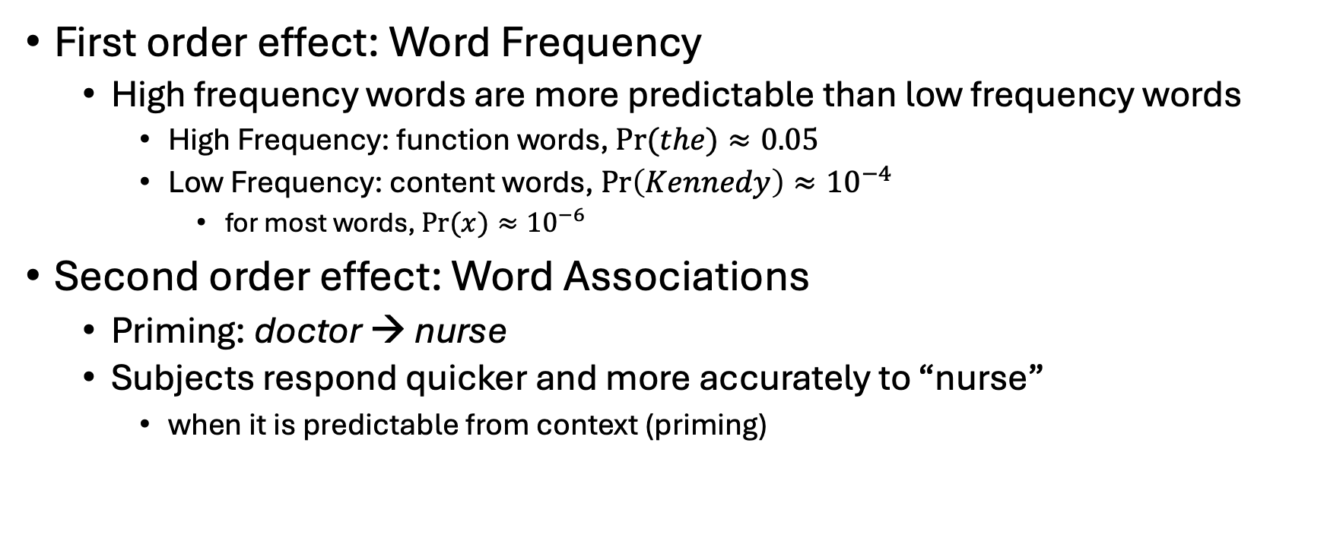
More predictable contexts → Faster reaction times (RT) (Predictability can be estimated from corpora)
First order effect: Word Frequency
High frequency words are more predictable than low frequency words
High Frequency: function words, $Pr⁡(the)≈0.05$
Low Frequency: content words, $\operatorname{Pr}\left(Kennedy\right)≈{10}^{−4}$
for most words, $Pr⁡(x)≈{10}^{−6}$
Second order effect: Word Associations
Priming: doctor → nurse
Subjects respond quicker and more accurately to “nurse”
when it is predictable from context (priming)

Slide 39
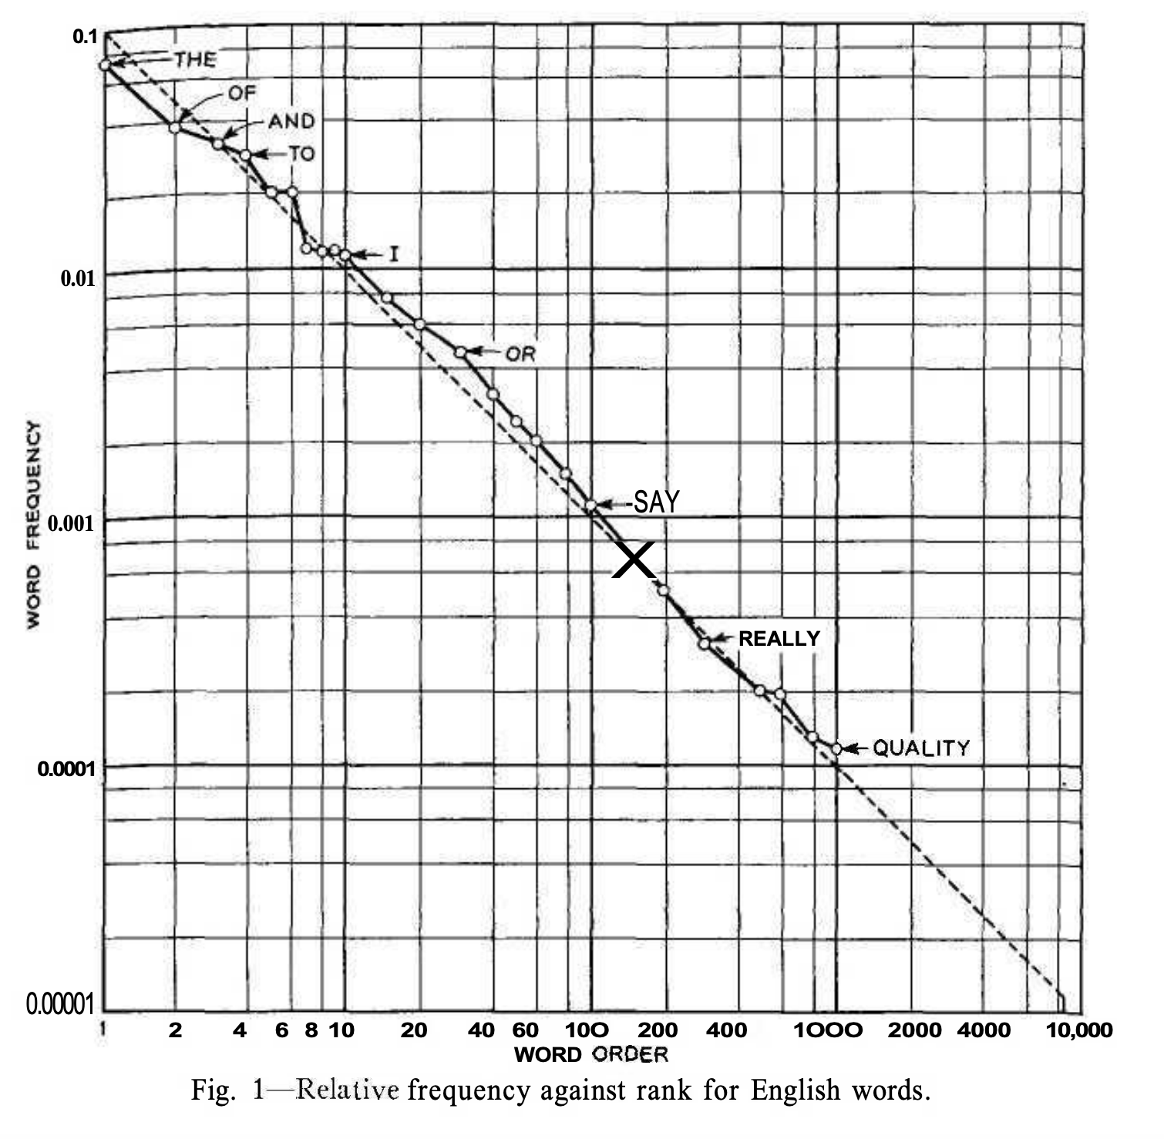

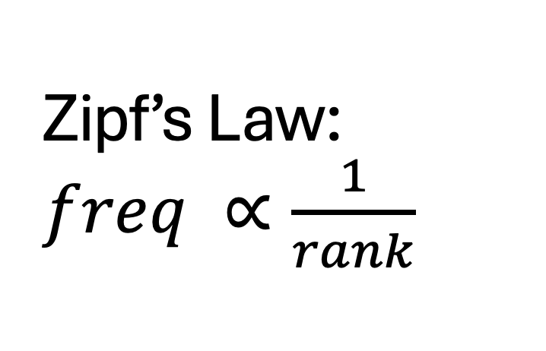

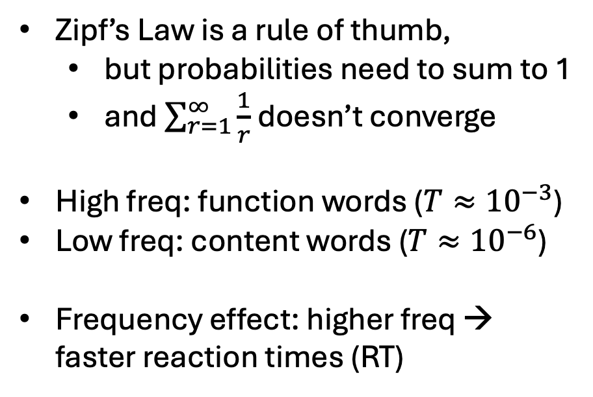

Zipf’s Law: $freq ∝\frac{1}{rank}$
Function Words
$$\operatorname{Pr}\left(x\right)>T$$
$$T$$
Zipf’s Law is a rule of thumb,
but probabilities need to sum to 1
and $\sum_{r=1}^{∞}{\frac{1}{r}}$ doesn’t converge
High freq: function words ($T≈{10}^{−3}$)
Low freq: content words ($T≈{10}^{−6}$)
Frequency effect: higher freq → faster reaction times (RT)
Content Words
$$\operatorname{Pr}\left(x\right)<T$$
Figure from Shannon’s paper on entropy of English

Slide 40
Predictable contexts
Easier for people
Subjects respond quicker and more accurately
when contexts are predictable
Also, easier for machines
Web search
Bots
Information Retrieval
Speech recognition
Vision
Predictability varies over many factors: genre, time, space, etc.

Slide 41
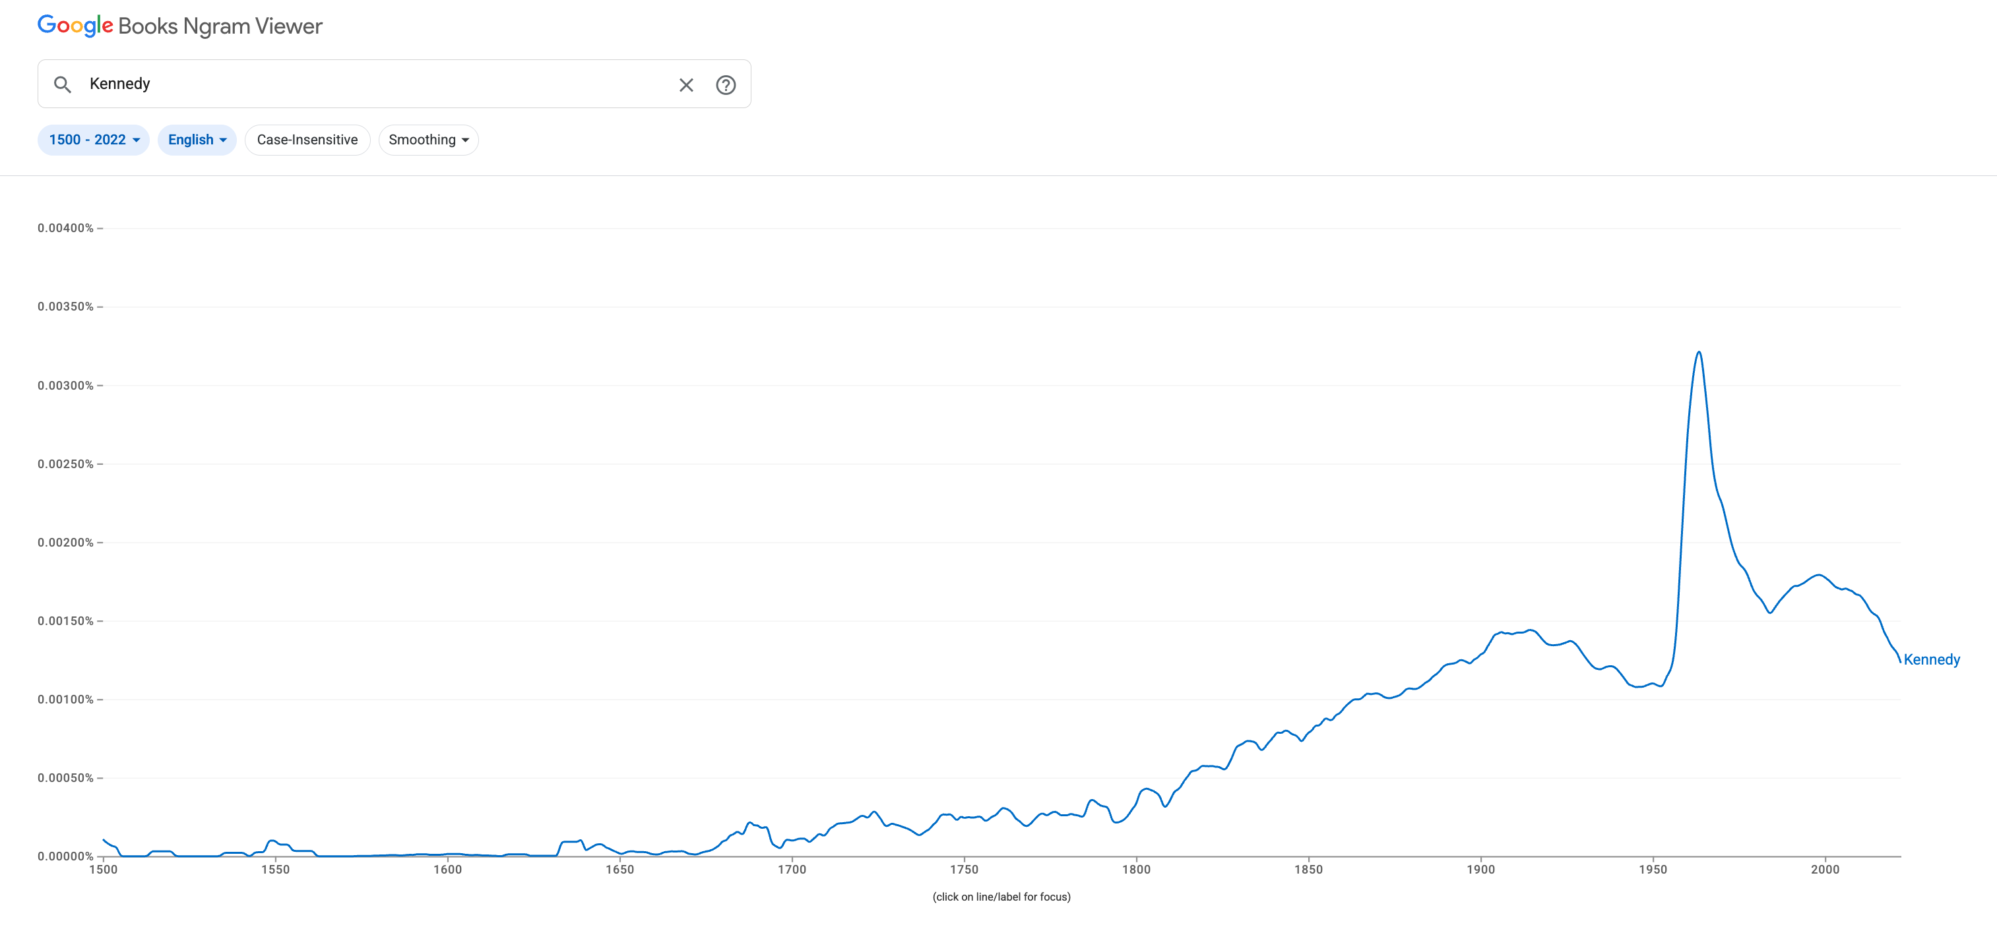
Google Ngrams for “Kennedy” Books published since 1500
Brown Corpus
WW II
Frequency depends on time

Slide 42
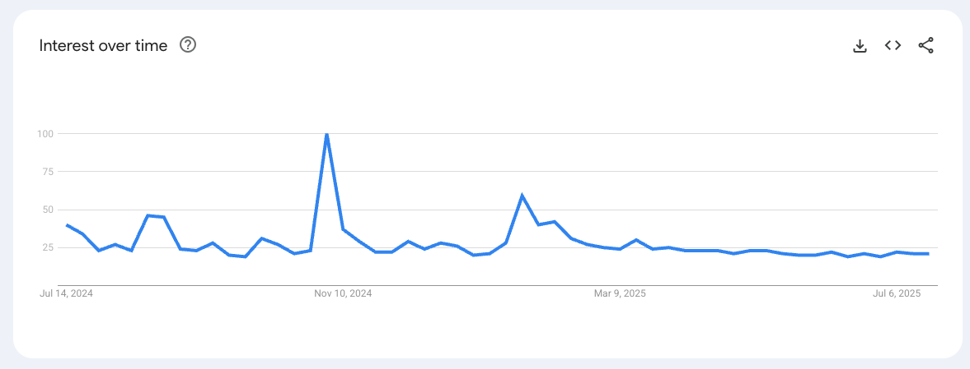
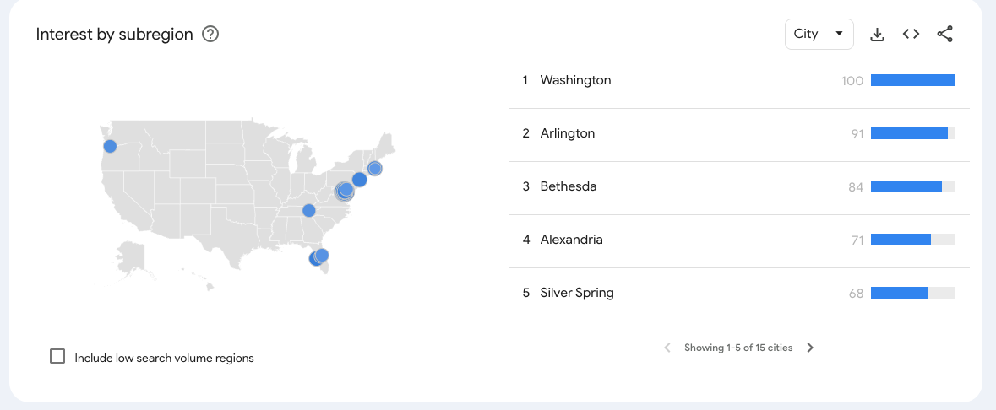
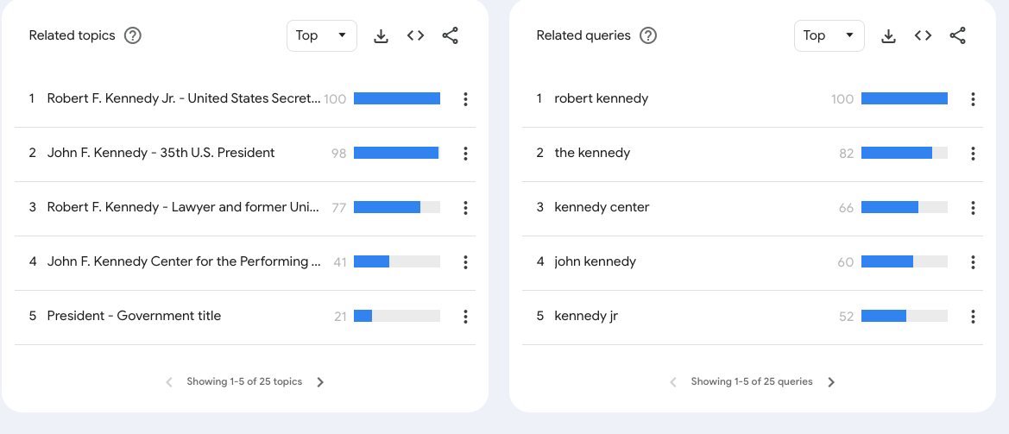
Google Trends for “Kennedy”: Queries over 12 months (7/24-7/25)
Election

Slide 43
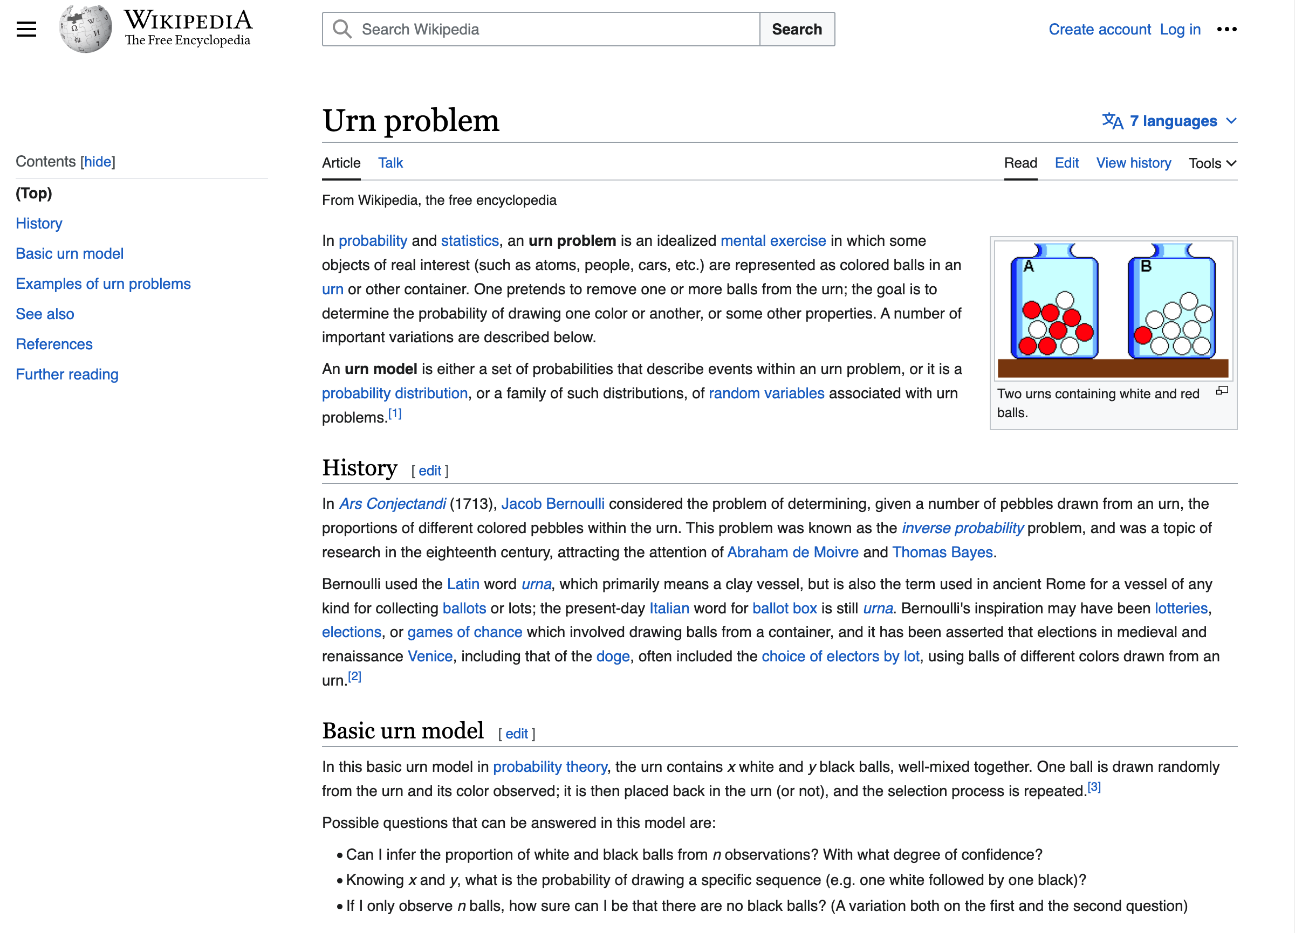
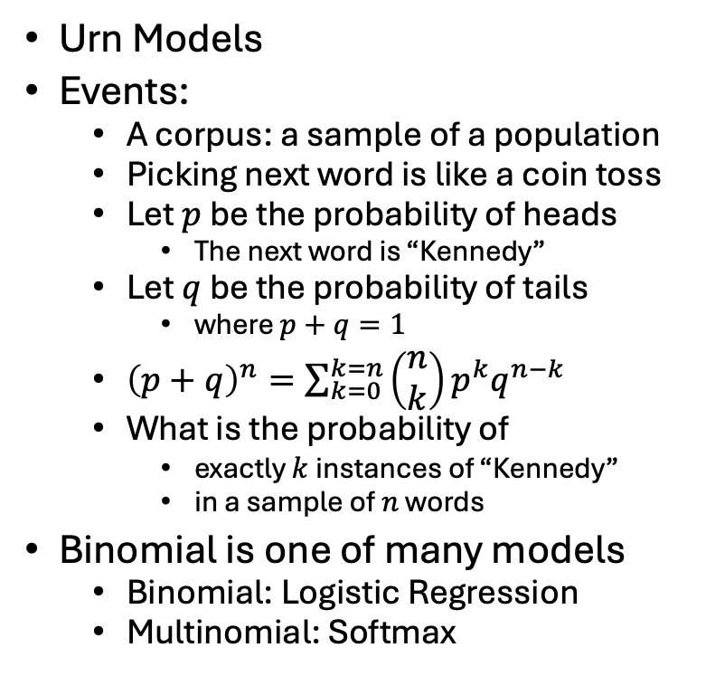
Probability Theory
Urn Models
Events:
A corpus: a sample of a population
Picking next word is like a coin toss
Let $p$ be the probability of heads
The next word is “Kennedy”
Let $q$ be the probability of tails
where $p+q=1$
${\left(p+q\right)}^{n}=\sum_{k=0}^{k=n}{\left(\begin{matrix}n \\ k\end{matrix}\right)}p^{k}q^{n−k}$
What is the probability of
exactly $k$ instances of “Kennedy”
in a sample of $n$ words
Binomial is one of many models
Binomial: Logistic Regression
Multinomial: Softmax

Slide 44
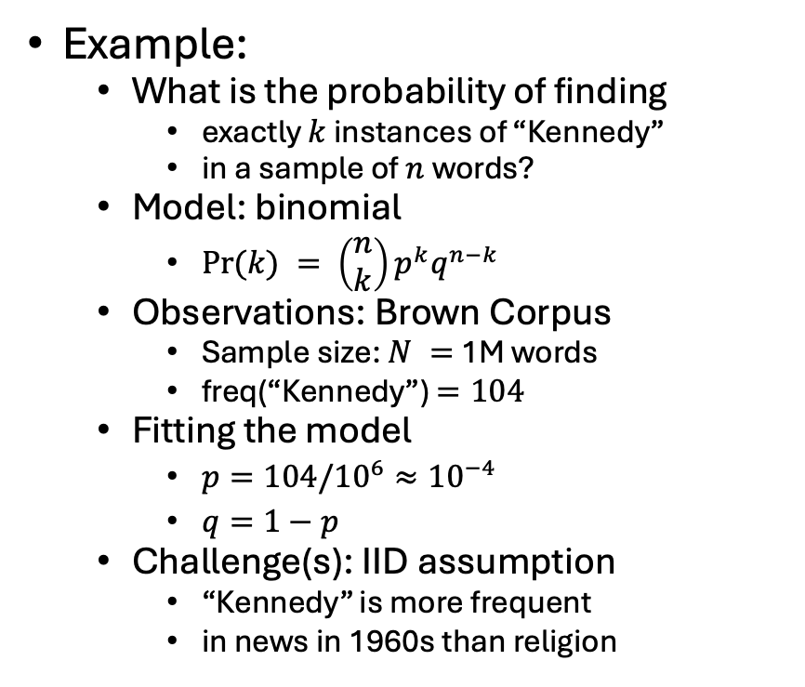
Statistics: Combining Models with Observations
Models (from Probability)
Binomial
Multinomial
Normal
Poisson
Exponential
Observations: Corpora
Assumptions: IID
https://en.wikipedia.org/wiki/Independent_and_identically_distributed_random_variables
Example:
What is the probability of finding
exactly $k$ instances of “Kennedy”
in a sample of $n$ words?
Model: binomial
$Pr⁡(k) = \left(\begin{matrix}n \\ k\end{matrix}\right)p^{k}q^{n−k}$
Observations: Brown Corpus
Sample size: $N =$ 1M words
freq(“Kennedy”) $=104$
Fitting the model
$p=104/{10}^{6}≈{10}^{−4}$
$q=1−p$
Challenge(s): IID assumption
“Kennedy” is more frequent
in news in 1960s than religion

Slide 45
Freq depends on many factors, e.g, genre, time

Slide 46
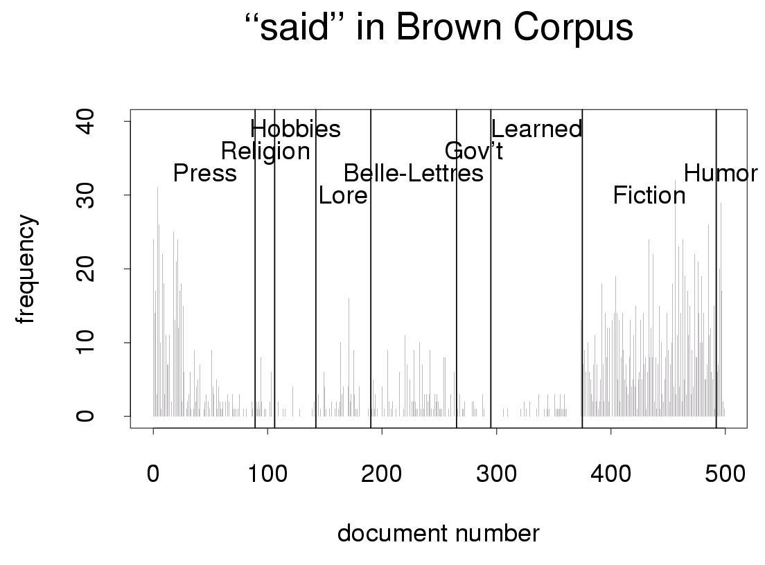
Freq depends on news type (reportage vs. editorial)

Slide 47
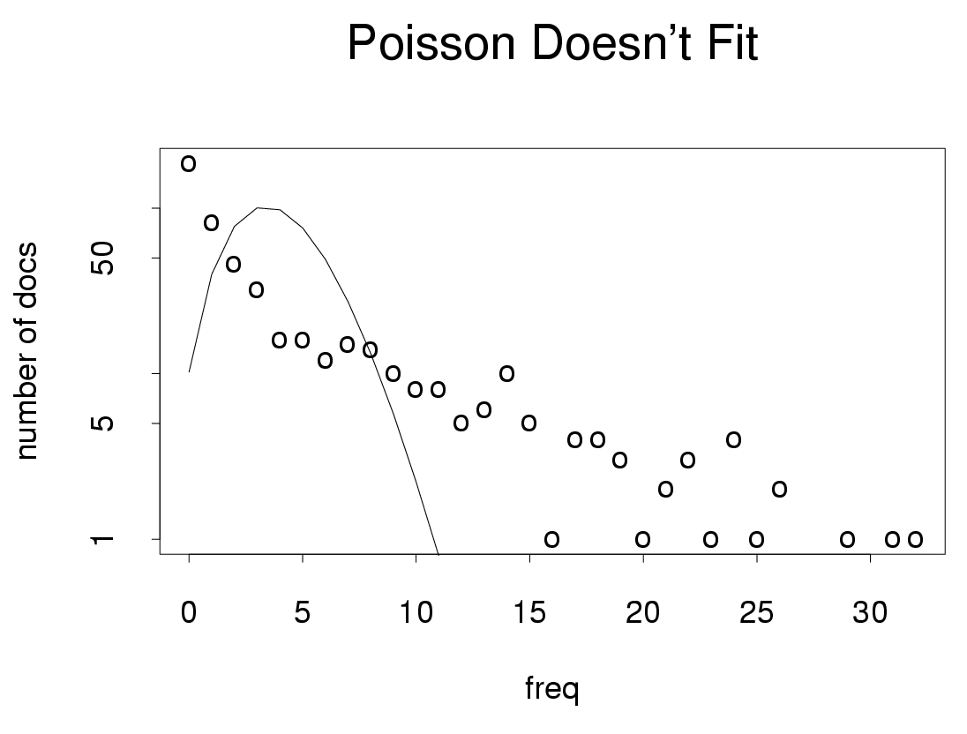
Burstiness/
Contagious
Freq depends many hidden variables

Slide 48
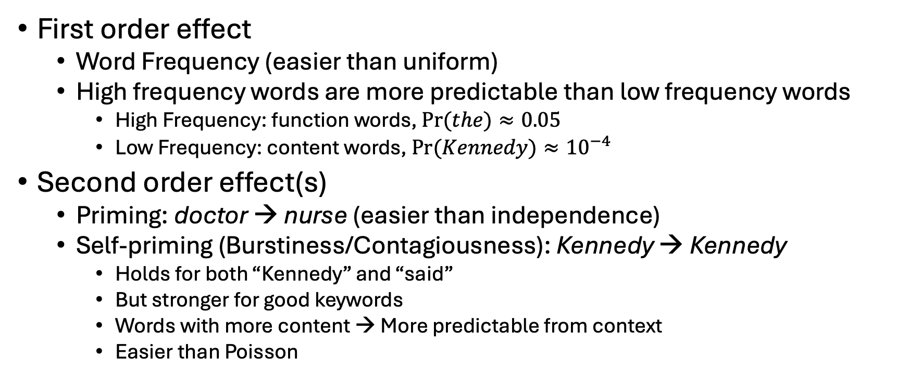
Priming & Self-Priming (Burstiness) Reality is easier than chance (Uniform/Poisson)
First order effect
Word Frequency (easier than uniform)
High frequency words are more predictable than low frequency words
High Frequency: function words, $Pr⁡(the)≈0.05$
Low Frequency: content words, $Pr⁡(Kennedy)≈{10}^{−4}$
Second order effect(s)
Priming: doctor → nurse (easier than independence)
Self-priming (Burstiness/Contagiousness): Kennedy → Kennedy
Holds for both “Kennedy” and “said”
But stronger for good keywords
Words with more content → More predictable from context
Easier than Poisson

Slide 49
Agenda
Bigger Picture: A personal perspective not found in textbooks
Corpora
Lexical Semantics
Word Associations
Information Theory
PMI → Word2Vec → Bots

Slide 50
Intermission 1

Slide 51
Agenda
Bigger Picture: A personal perspective not found in textbooks
Corpora
Lexical Semantics
Word Associations
Information Theory
PMI → Word2Vec → Bots

Slide 52
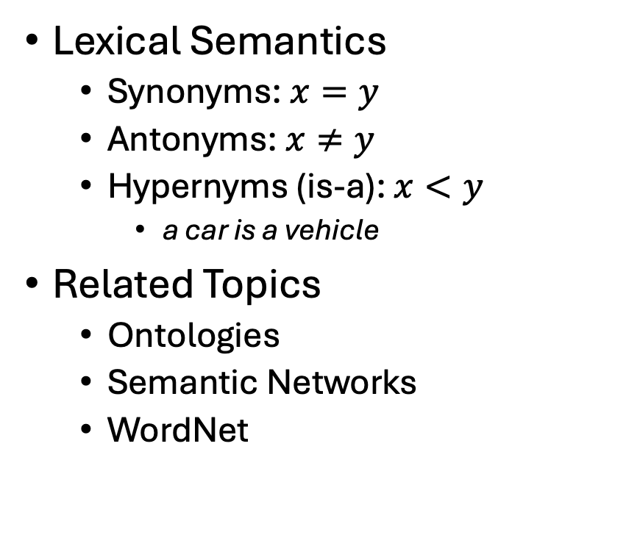
Lexical Semantics → Embeddings
Lexical Semantics
Synonyms: $x=y$
Antonyms: $x≠y$
Hypernyms (is-a): $x<y$
a car is a vehicle
Related Topics
Ontologies
Semantic Networks
WordNet
Vectors/Embeddings:
More modern view of meaning
Behind much of the recent excitement in AI
Large Language Models (LLM)
Bots: ChatGPT, DeepSeek
Equivalence Relation
Partial Order

Slide 53

So far
Jurafsky’s Slide 17
Word-Sense Disambiguation (WSD)
Concepts or word senses
Have a complex many-to-many association with words (homonymy, multiple senses)
Have relations with each other
Synonymy
Antonymy
Similarity
Relatedness
Connotation
Collocations
Collocations
Collocations
Collocations
Collocations
Large PMI
https://web.stanford.edu/~jurafsky/slp3/slides/vectorsemantics2024.pdf

Slide 54
Collocations: Examples >> Definitions (George Miller: Chomsky’s Mentor & WordNet)
Exercise: Use “erode” in a sentence:
My family erodes a lot.
to eat into or away; destroy by slow consumption or disintegration
Battery acid had eroded the engine.
Inflation erodes the value of our money.
Miller’s Conclusion:
Dictionary examples are more helpful than definitions
Effective examples:
Make heavy use of collocations
Definition
Examples
6/27/2014
Fillmore Workshop
54

Slide 55
Corpus-Based Lexicography
Examples should be “natural”
Based on corpus evidence
Avoid temptation to make up examples
Representative (sorted by frequency)
Classify concordances by sense (collocates)
Sort senses by frequency

Slide 56
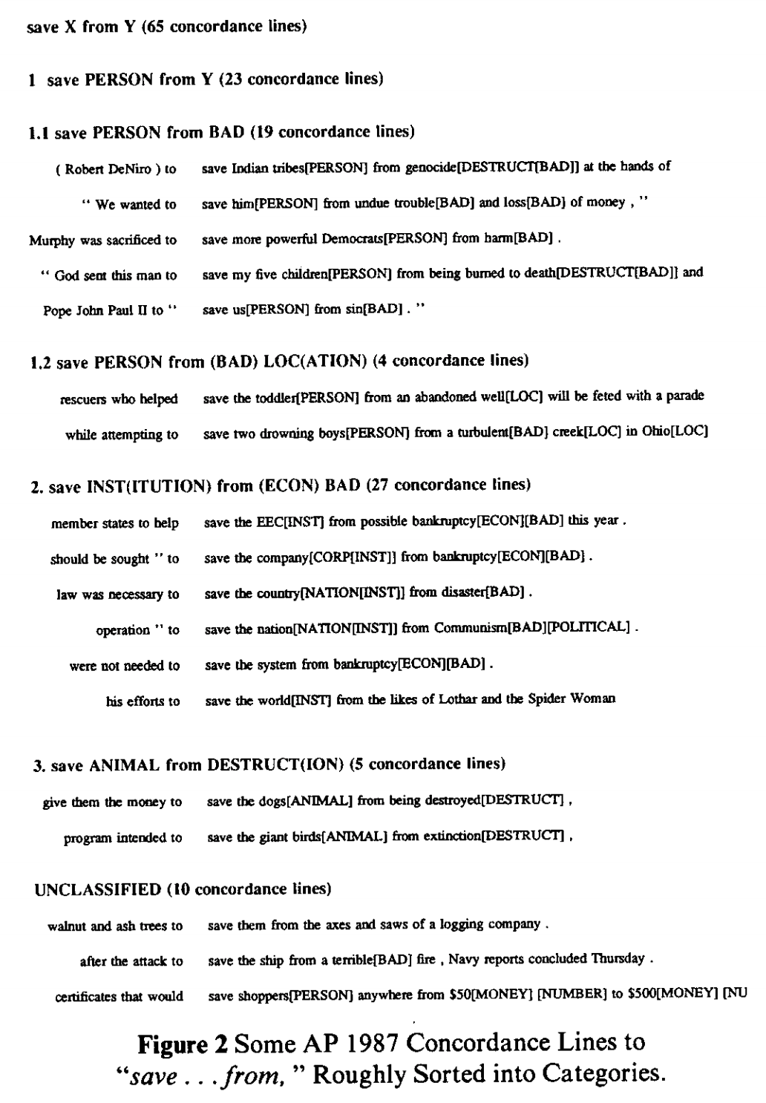

Save <good> from <bad>

Slide 57


PMI $≠$ Lexical Semantics $≠$ Back Translation
PMI estimates collocations
Probability that two words
appear near one another,
normalized by chance
good / OK / bad
Back Translation
Random walk over translations
Good → Bien → OK
But not, good → … → bad
Large PMI
Collocations:
Truth, Justice & American Way
Red, White and Blue
Synonyms: true / correct
Antonyms: true / false
Part-Whole: window /house

Slide 58
Agenda
Bigger Picture: A personal perspective not found in textbooks
Corpora
Lexical Semantics
Word Associations
Information Theory
PMI → Word2Vec → Bots

Slide 59


Word Associations https://wordassociation.org/

Slide 60
https://en.wikipedia.org/wiki/Gestalt_psychology
“atomism,” also known as “elementalism,’’
the view that all knowledge, even complex abstract ideas, is built from simple, elementary constituents
“sensationalism,”
the view that the simplest constituents—the atoms of thought—are elementary sense impressions
“associationism,”
the view that more complex ideas arise
from the association of simpler ideas.
PMI: Word Associations

Slide 61



Priming & Word Associations Task: Subject is given two strings and responds “yes” if both are words

Slide 62

Size of Priming Effect (Split Second): 855 msec v. 940 msec (from previous slide)
System 1 vs System 2
Fast (Unconscious)
Slow
Rules of Thumb
500 msec:
Push a button after tone
1000 msec: Lexical retrieval
Push one button for words and another button for non-words
Longer: System 2
Explain your work

Slide 63
Thinking Fast and Slow Quoted from pp. 20-21
System 1 operates automatically and quickly,
with little or no effort and
no sense of voluntary control.
System 2 allocates attention to the effortful mental activities that demand it, including complex computations.
The operations of System 2 are often associated with the subjective experience of agency, choice, and concentration.

Slide 64
Consequences for Artificial Intelligence (AI)
Recent excitement in AI
Large Language Models (LLMs)
Deep Networks
ChatBots (ChatGPT)
RAG
Thus far, AI is more effective
for System 1 tasks
than System 2 tasks
What about bots for programming?
That sounds like a System 2 task
But bots program by table lookup
More like lexical retrieval
than problem solving
Interpretability: Open problem
Bots find it hard to explain their work
Just as people find it hard to explain
what happens during lexical retrieval

Slide 65
Agenda
Bigger Picture: A personal perspective not found in textbooks
Corpora
Lexical Semantics
Word Associations
Information Theory
PMI → Word2Vec → Bots

Slide 66
Intermission 2

Slide 67
Agenda
Bigger Picture: A personal perspective not found in textbooks
Corpora
Lexical Semantics
Word Associations
Information Theory
PMI → Word2Vec → Bots

Slide 68



Pointwise Mutual Information (PMI)
PMI has a simple interpretation
$\operatorname{Pr}\left(x\right)≈\frac{f\left(x\right)}{N}$
$\operatorname{Pr}\left(y\right)≈\frac{f\left(y\right)}{N}$
$\operatorname{Pr}\left(x,y\right)≈\frac{f\left(x,y\right)}{N}$
PMI compares P(x,y) with chance
Chance $= P(x) P(y)$
If there is a genuine association
then $P(x,y) ≫ P(x) P(y)$
Uninteresting associations
$P(x,y) ≈ P(x) P(y)$

Slide 69

There is no data like more data
Counts are growing 1000x per decade
(same as disks)
Counts are growing 1000x per decade
(same as disks)
Rising Tide of Data Lifts All Boats

Slide 70

Pointwise Mutual Information (PMI)
Entropy:
$H\left(X\right)=−\sum_{x∈X}{p\left(x\right)\log_{2}}p\left(x\right)$
Mutual Information
$I\left(X;Y\right)=H\left(X\right)−H\left(X | Y\right)$
$I\left(Y;X\right)=H\left(Y\right)−H(Y|X)$
Properties:
Symmetry $I\left(X;Y\right)=I(Y;X)$
Non-negative: $I(X;Y)≥0$
Pointwise

Slide 71


Pointwise Mutual Information (PMI)
PMI has a simple interpretation
PMI compares P(x,y) with chance
Chance = P(x) P(y)
If there is a genuine association
then P(x,y) >> P(x) P(y)
Uninteresting associations
P(x,y) ≈ P(x) P(y)
Entropy:
$H\left(X\right)=−\sum_{x∈X}{p\left(x\right)\log_{2}}p\left(x\right)$
Mutual Information
$I\left(X;Y\right)=H\left(X\right)−H\left(X | Y\right)$
$I\left(X;Y\right)=H\left(Y\right)−H(Y|X)$
Properties:
Symmetry $I\left(X;Y\right)=I(Y;X)$
Non-negative: $I(X;Y)≥0$
Pointwise

Slide 72



Slide 73



Telephone
$$X$$
$$Y$$

Slide 74

Telephone
Gzip
Encoder
Decoder

Slide 75


Slide 76

Perplexity & Entropy
Lexical Retrieval
Perplexity $2^{H(x)}$: Summary of number of guesses
Entropy $H\left(x\right)$: Number of bits required to store $x$
Bandwidth of a communication channel
$H\left(X\right)=−\sum{p\log_{2} p}$
Gzip

Slide 77

Zipf’s Law: $freq \sim \frac{1}{rank}$
Function Words
Non-uniform probabilities → Opportunities for compression
Content Words

Slide 78
Agenda
Bigger Picture: A personal perspective not found in textbooks
Corpora
Lexical Semantics
Word Associations
Information Theory
PMI → Word2Vec → Bots

Slide 79

PMI → Word2Vec
Word2Vec: Represent words as vectors
Embed words in a vector space
$sim(x,y) ≈ cos⁡(x,y)$
Dimension Reduction
Singular Value Decomposition (SVD)
Connect the dots with PMI
Motivation for embeddings
Visualization
Semantic types: cities vs. countries
Analogies

Slide 80


SVD: Singular Value Decomposition
 | c1 | c2 | c3 | c4 | c5 | m1 | m2 | m3 | m4
human | 1 | 0 | 0 | 1 | 0 | 0 | 0 | 0 | 0
interface | 1 | 0 | 1 | 0 | 0 | 0 | 0 | 0 | 0
computer | 1 | 1 | 0 | 0 | 0 | 0 | 0 | 0 | 0
user | 0 | 1 | 1 | 0 | 1 | 0 | 0 | 0 | 0
system | 0 | 1 | 1 | 2 | 0 | 0 | 0 | 0 | 0
response | 0 | 1 | 0 | 0 | 1 | 0 | 0 | 0 | 0
time | 0 | 1 | 0 | 0 | 1 | 0 | 0 | 0 | 0
EPS | 0 | 0 | 1 | 1 | 0 | 0 | 0 | 0 | 0
survey | 0 | 1 | 0 | 0 | 0 | 0 | 0 | 0 | 1
trees | 0 | 0 | 0 | 0 | 0 | 1 | 1 | 1 | 0
graph | 0 | 0 | 0 | 0 | 0 | 0 | 1 | 1 | 1
minors | 0 | 0 | 0 | 0 | 0 | 0 | 0 | 1 | 1
M: term by doc matrix
$M≈UDV^{T}$
Dimension Reduction
U,D,Vt = np.linalg.svd(M)
$\hat{M}=U@\text{np}\text{.}\text{diag}(D)@V^{T}$
Dimension reduction
D[2:]=0
$\hat{M}=U@\text{np}\text{.}\text{diag}(D)@V^{T}$

Slide 81



Dimension Reduction → Visualization

Slide 82


plot(hclust(as.dist(1-cor(m)))
 | c1 | c2 | c3 | c4 | c5 | m1 | m2 | m3 | m4
human | 1 | 0 | 0 | 1 | 0 | 0 | 0 | 0 | 0
interface | 1 | 0 | 1 | 0 | 0 | 0 | 0 | 0 | 0
computer | 1 | 1 | 0 | 0 | 0 | 0 | 0 | 0 | 0
user | 0 | 1 | 1 | 0 | 1 | 0 | 0 | 0 | 0
system | 0 | 1 | 1 | 2 | 0 | 0 | 0 | 0 | 0
response | 0 | 1 | 0 | 0 | 1 | 0 | 0 | 0 | 0
time | 0 | 1 | 0 | 0 | 1 | 0 | 0 | 0 | 0
EPS | 0 | 0 | 1 | 1 | 0 | 0 | 0 | 0 | 0
survey | 0 | 1 | 0 | 0 | 0 | 0 | 0 | 0 | 1
trees | 0 | 0 | 0 | 0 | 0 | 1 | 1 | 1 | 0
graph | 0 | 0 | 0 | 0 | 0 | 0 | 1 | 1 | 1
minors | 0 | 0 | 0 | 0 | 0 | 0 | 0 | 1 | 1

Slide 83

plot(hclust(as.dist(1-cor(t(m))))
 | c1 | c2 | c3 | c4 | c5 | m1 | m2 | m3 | m4
human | 1 | 0 | 0 | 1 | 0 | 0 | 0 | 0 | 0
interface | 1 | 0 | 1 | 0 | 0 | 0 | 0 | 0 | 0
computer | 1 | 1 | 0 | 0 | 0 | 0 | 0 | 0 | 0
user | 0 | 1 | 1 | 0 | 1 | 0 | 0 | 0 | 0
system | 0 | 1 | 1 | 2 | 0 | 0 | 0 | 0 | 0
response | 0 | 1 | 0 | 0 | 1 | 0 | 0 | 0 | 0
time | 0 | 1 | 0 | 0 | 1 | 0 | 0 | 0 | 0
EPS | 0 | 0 | 1 | 1 | 0 | 0 | 0 | 0 | 0
survey | 0 | 1 | 0 | 0 | 0 | 0 | 0 | 0 | 1
trees | 0 | 0 | 0 | 0 | 0 | 1 | 1 | 1 | 0
graph | 0 | 0 | 0 | 0 | 0 | 0 | 1 | 1 | 1
minors | 0 | 0 | 0 | 0 | 0 | 0 | 0 | 1 | 1

Slide 84


Similarity Matrix (S) → Embedding (Z)
Similarity of columns
Similarity of rows
$\hat{M}=UDV^{T}$
$S_{1} = M M^{T}$
$S_{1}≈Z Z^{T}$
where $Z=U D$
Embedding
$Z∈ℛ^{n×d}$
$n$: rows of $\hat{M}$ (# of docs)
$d$: hidden dimensions
dimension reduction: $d≪n$
$\hat{M}=UDV^{T}$
${\hat{M}}^{T}$=$VDU^{T}$
$S_{2} = M^{T}M$
$S_{2}≈Z Z^{T}$
where $Z=V D$
Embedding
$Z∈ℛ^{n×d}$
$n$: columns of $\hat{M}$ (# of words in vocab)
$d$: hidden dimensions
dimension reduction: $d≪n$

Slide 85

PMI Matrix (S) → Embedding (Z)
Let $S$ be a PMI matrix
where $S∈ℛ^{v×v}$ (too large to materialize)
$S$ is symmetric
$v$: # of words in vocabulary
$S=UDV^{T}$
$S$ $≈Z Z^{T}$
where $Z=U \sqrt{D}$
Embedding
$Z∈ℛ^{v×d}$ (small enough to materialize)
dimension reduction: $d≪v$

Slide 86



Word2Vec: $sim\left(x,y\right)=\cos\left(vec\left(x\right), vec\left(y\right)\right)≈PMI(x,y)$ https://code.google.com/archive/p/word2vec/
Linguistic generalizations
Word associations (dist in plot)
Features (red line)
Countries & Capitals
Analogies:
Man : Woman :: King : x
x → queen
Athens : Greece :: Bangkok: x
x → Thailand

Slide 87


man : woman :: king : x
Vector addition & subtraction
$vec\left(king+woman −man\right)=vec\left(king\right)+vec\left(woman\right)−vec(man)$
Analogies
$\hat{x}=\underset{x∈V}{ARGMAX}{sim(x^{′}, king+woman −man)}$
Near misses

Slide 88

Some analogies are easier than others
Tweets
RT @tallinzen: sure, king:queen etc, but did you know word2vec gets real SAT analogies right just 1% of the time?
15 copies of this tweet
Some by NLP experts
Resources Debate
WordNet &
British National Corpora

Slide 89

Levy & Goldberg (NIPS-2014) Word2Vec ≈ PMI (Pointwise Mutual Info)
Levy & Goldberg (NIPS-2014) is a theoretical arg
Plots → correlations are large, but far from perfect
Materials:
N = 22 words (11 cities + 11 countries)
N (N-1)/2 = 231 pairs of words (points)
type in {city, country}
Color:
Green → type match
Red → type mismatch

Slide 90


PMI → Word2Vec → HuggingFace embeddings
Word2vec:
words → vectors
$Z∈ℛ^{v×d}$
$v$: # of words in vocabulary
HuggingFace embeddings:
texts → vectors
$Z∈ℛ^{n×d}$
$n$: # of input texts
https://github.com/kwchurch/JSALT_Better_Together/blob/main/src/make_HF_embeddings.py

Slide 91
Conclusions
Bigger Picture: A personal perspective not found in textbooks
Corpora
Lexical Semantics
Word Associations
Information Theory
PMI → Word2Vec → Bots

